Slide 1
Chapter 1:
Router Initial Configuration
Notes:
Cisco Networking Academy Program
Routing and Switching Essentials v6.0
Chapter 1: Dynamic Routing

Slide 2
Chapter 1 - Sections & Objectives
1.1 Router Initial Configuration
  Describe the primary functions and features of a router.
  Configure basic settings on a router to route between two directly-connected networks, using CLI.
  Verify connectivity between two networks that are directly connected to a router.
1.2 Routing Decisions
  Explain the encapsulation and de-encapsulation process used by routers when switching packets between interfaces.
  Explain the path determination function of a router.
1.3 Router Operation
  Explain routing table entries for directly connected networks.
  Explain how a router builds a routing table of directly connected networks.
  Explain how a router builds a routing table using static routes.
  Explain how a router builds a routing table using a dynamic routing protocol.
Notes:
2

Slide 3
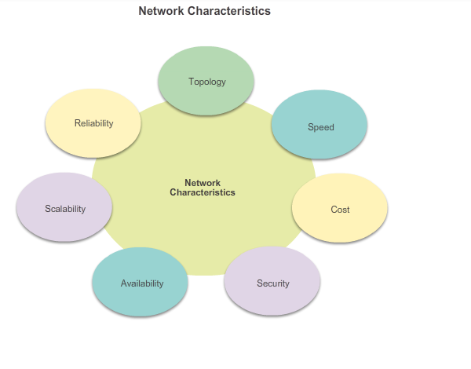
Router Functions
Characteristics of a Network
Notes:
1.1 - Router Initial Configuration
1.1.1 - Router Functions
1.1.1.1 - Characteristics of a Network

Slide 4
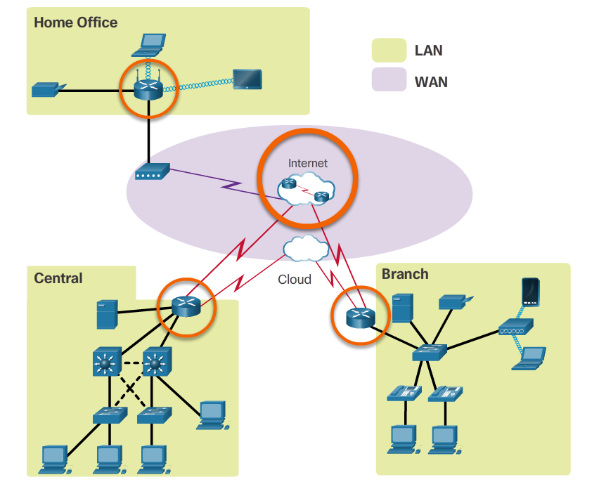
Router Functions
Why Routing?
The router is responsible for the routing of traffic between networks.
Notes:
1.1 - Router Initial Configuration
1.1.1 - Router Functions
1.1.1.2 - Why Routing?

Slide 5
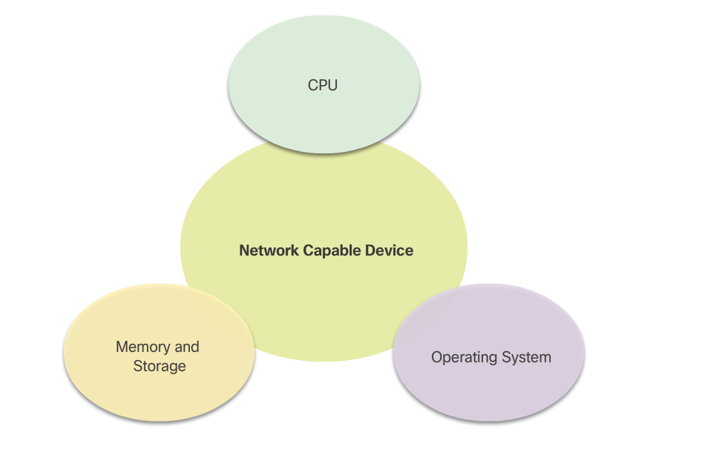
Router Functions
Routers are Computers
Routers are specialized computers containing the following required components to operate:
  Central processing unit (CPU)
  Operating system (OS) - Routers use Cisco IOS
  Memory and storage (RAM, ROM, NVRAM, Flash, hard drive)
Notes:
1.1 - Router Initial Configuration
1.1.1 - Router Functions
1.1.1.3 - Routers are Computers

Slide 6
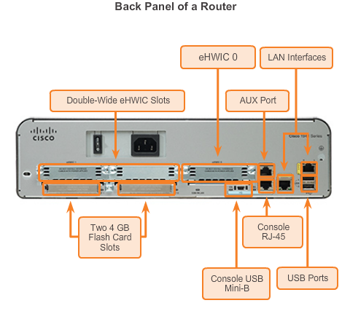
Router Functions
Routers are Computers (cont.)
Routers use specialized ports and network interface cards to interconnect to other networks.
Notes:
1.1 - Router Initial Configuration
1.1.1 - Router Functions
1.1.1.3 - Routers are Computers (cont.)

Slide 7
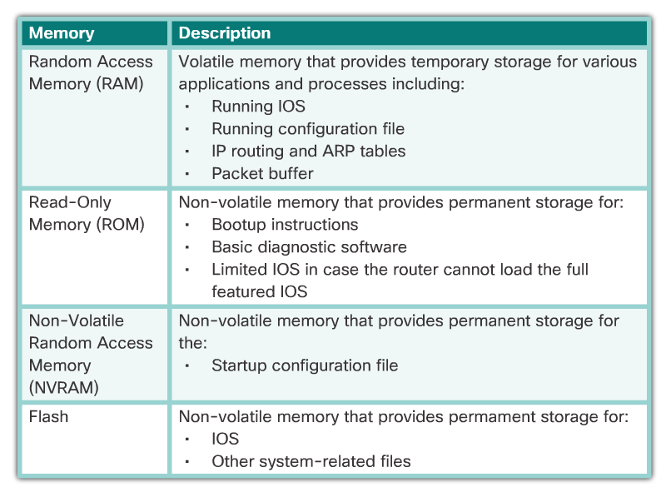
Router Memory Functions
Notes:
1.1 - Router Initial Configuration
1.1.1 - Router Functions
1.1.1.3 - Routers are Computers

Slide 8
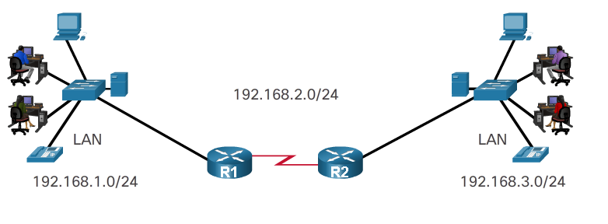
Router Functions
Routers Choose Best Paths
Routers use static routes and dynamic routing protocols to learn about remote networks and build their routing tables.
Routers use routing tables to determine the best path to send packets.
Routers encapsulate the packet and forward it to the interface indicated in routing table.
Notes:
1.1 - Router Initial Configuration
1.1.1 - Router Functions
1.1.1.5 Routers Choose Best Paths

Slide 9
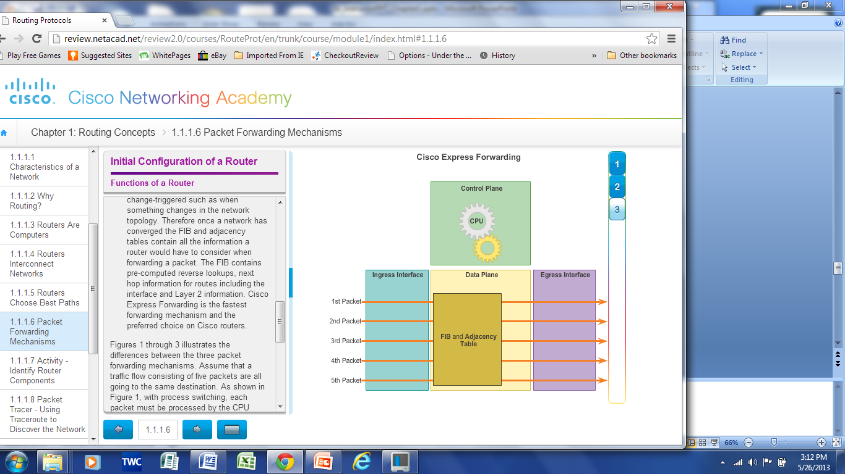
Router Functions
Packet Forwarding Methods
Process switching – An older packet forwarding mechanism still available for Cisco routers.
Fast switching – A common packet forwarding mechanism which uses a fast-switching cache to store next hop information.
Cisco Express Forwarding (CEF) – The most recent, fastest, and preferred Cisco IOS packet-forwarding mechanism.
Notes:
1.1 - Router Initial Configuration
1.1.1 - Router Functions
1.1.1.6 – Packet Forwarding Methods

Slide 10
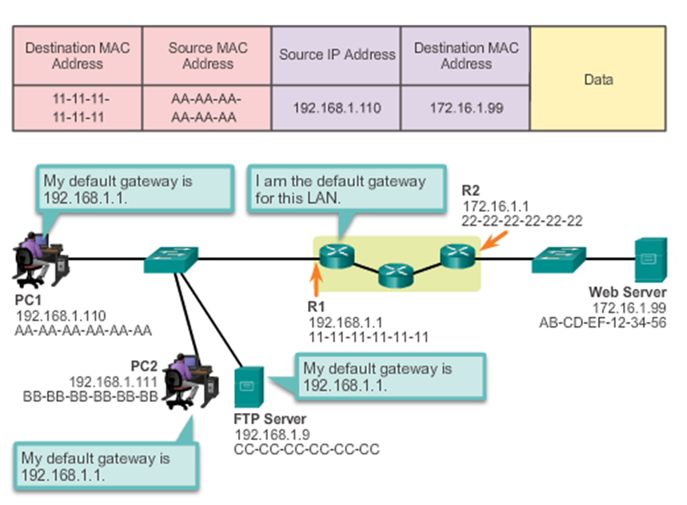
Connect Devices
Default Gateways
To enable network access devices, must be configured with the following IP address information:
  IP address - Identifies a unique host on a local network.
  Subnet mask - Identifies the host’s network subnet.
  Default gateway - Identifies the router a packet is sent to when the destination is not on the same local network subnet.
Notes:
1.1 - Router Initial Configuration
1.1.2 – Connect Devices
1.1.2.2 - Default Gateways

Slide 11
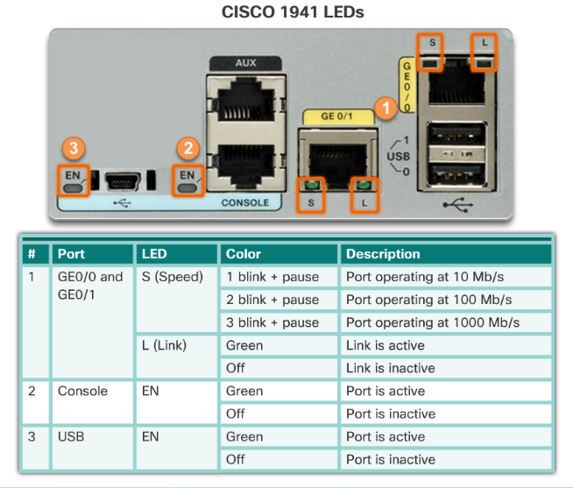
Connect devices
Device LEDs
Notes:
1.1 - Router Initial Configuration
1.1.2 – Connect Devices
1.1.2.5 - Device LEDs

Slide 12
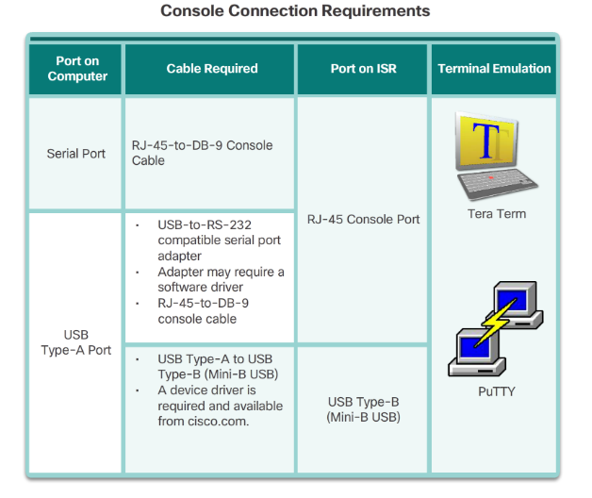
Connect Devices
Console Access
Console Access
Notes:
1.1 - Router Initial Configuration
1.1.2 – Connect Devices
1.1.2.6 - Console Access

Slide 13
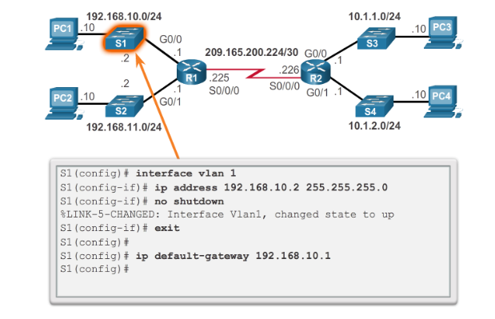
Connect Devices
Enable IP on a Switch
Network infrastructure devices require IP addresses to enable remote management.
On a switch, the management IP address is assigned on a virtual interface called a switched virtual interface (SVI)
Notes:
1.1 - Router Initial Configuration
1.1.2 – Connect Devices
1.1.2.7 - Enable IP on a Switch

Slide 14
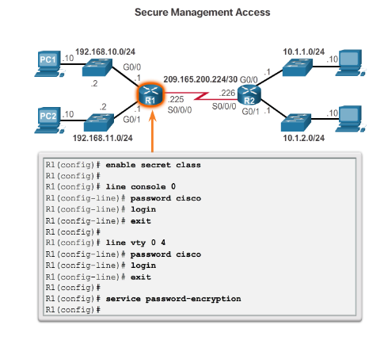
Router Basic Settings
Configure Router Basic Settings
Name the device – Distinguishes it from other routers
Secure management access – Secures privileged EXEC, user EXEC, and Telnet access, and encrypts passwords .
Configure a banner – Provides legal notification of unauthorized access.
Save the Configuration
Notes:
1.1 - Router Initial Configuration
1.1.3 – Router Operation
1.1.3.1 - Configure Router Basic Settings

Slide 15
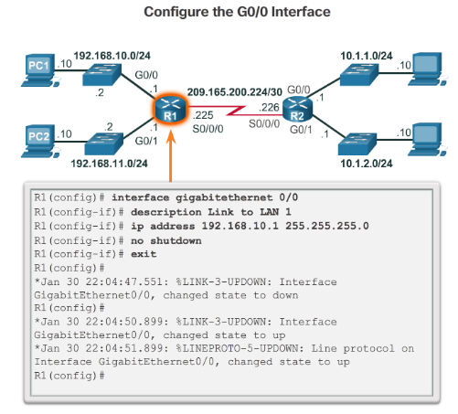
Router Basic Settings
Configure an IPv4 Router Interface
To be available, a router interface must be:
Configured with an address and subnet mask.
Activated using no shutdown command. By default LAN and WAN interfaces are not activated.
Configured with the clock rate command on the Serial cable end labeled DCE.
Optional description can be included.
Notes:
1.1 - Router Initial Configuration
1.1.3 – Router Operation
1.1.3.2 - Configure an IPv4 Router Interface

Slide 16
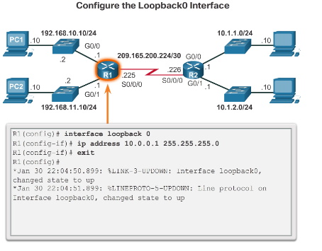
Router Basic Settings
Configure an IPv4 Loopback Interface
A loopback interface is a logical interface that is internal to the router:
It is not assigned to a physical port, it is considered a software interface that is automatically in an UP state.
A loopback interface is useful for testing.
It is important in the OSPF routing process.
Notes:
1.1 - Router Initial Configuration
1.1.3 – Router Operation
1.1.3.4 - Configure an IPv4 Loopback Interface

Slide 17
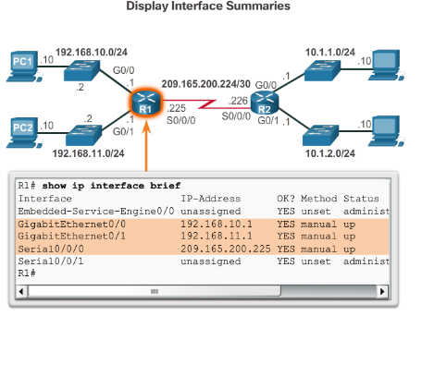
Verify Connectivity of Directly Connected Networks
Verify Interface Settings
Show commands are used to verify operation and configuration of interface:
show ip interfaces brief
show ip route
show running-config
Show commands that are used to gather more detailed interface information:
show interfaces
show ip interfaces
Notes:
1.1 - Router Initial Configuration
1.1.4 – Verify Connectivity of Directly Connected Networks
1.1.4.1 - Verify Interface Settings

Slide 18
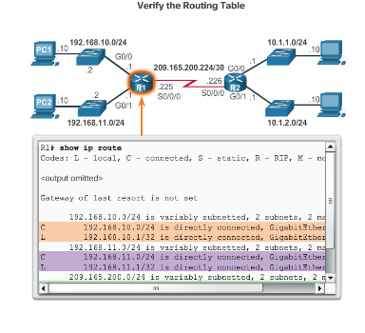
Verify Connectivity of Directly Connected Networks
Look at the route table
Notes:
1.1 - Router Initial Configuration
1.1.4 – Verify Connectivity of Directly Connected Networks
1.1.4.1 - Verify Interface Settings (cont.)

Slide 19
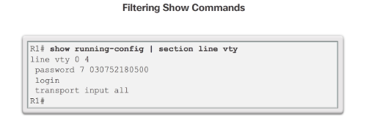
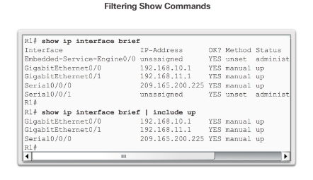
Verify Connectivity of Directly Connected Networks
Filter Show Command Output
Show command output can be managed using the following command and filters:
Use the terminal length number command to specify the number of lines to be displayed.
To filter specific output of commands use the (|)pipe character after show command. Parameters that can be used after pipe include:
  section, include, exclude, begin
Notes:
1.1 - Router Initial Configuration
1.1.4 – Verify Connectivity of Directly Connected Networks
1.1.4.3 - Filter Show Command Output

Slide 20
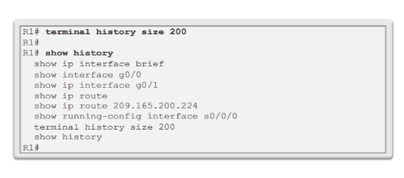
Verify Connectivity of Directly Connected Networks
Command History Feature
The command history feature temporarily stores a list of executed commands for access:
To recall commands press Ctrl+P or the UP Arrow.
To return to more recent commands press Ctrl+N or the Down Arrow.
By default, command history is enabled and the system captures the last 10 commands in the buffer. Use the show history privileged EXEC command to display the buffer contents.
Use the terminal history size user EXEC command to increase or decrease size of the buffer.
Notes:
1.1 - Router Initial Configuration
1.1.4 – Verify Connectivity of Directly Connected Networks
1.1.4.4 - Command History Feature

Slide 21
1.2 Routing Decisions
Notes:
1.2 - Routing Decisions

Slide 22
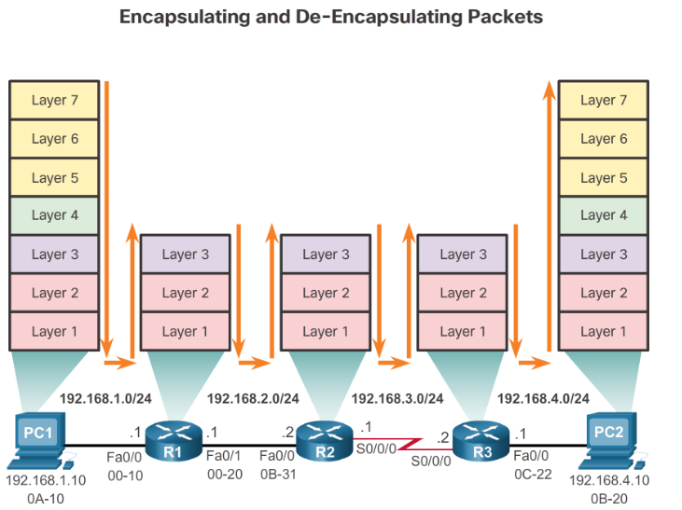
Switching Packets Between Networks
Router Switching Function
Notes:
1.2 - Routing Decisions
1.2.1 – Switching Packets Between Networks
1.2.1.1 - Router Switching Function

Slide 23
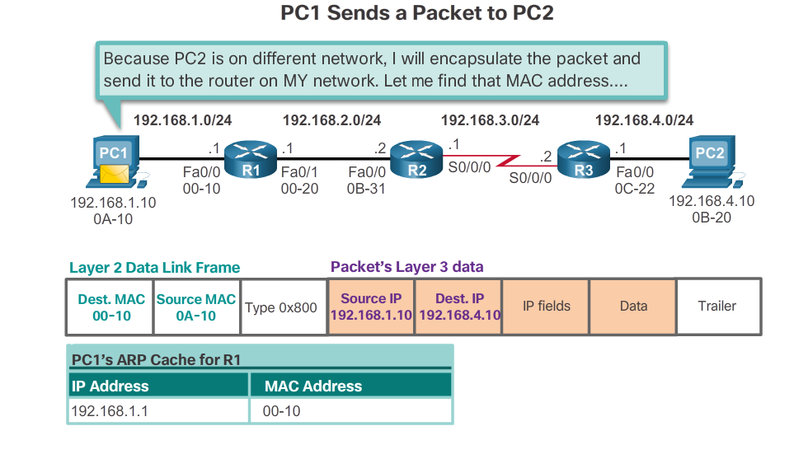
Switching Packets Between Networks
Send a Packet
Notes:
1.2 - Routing Decisions
1.2.1 – Switching Packets Between Networks
1.2.1.2 - Send a Packet

Slide 24
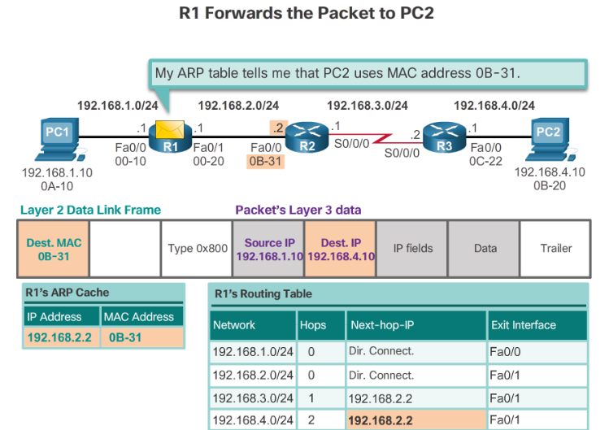
Switching Packets Between Networks
Forward to Next Hop
Notes:
1.2 - Routing Decisions
1.2.1 – Switching Packets Between Networks
1.2.1.3 - Forward to Next Hop

Slide 25
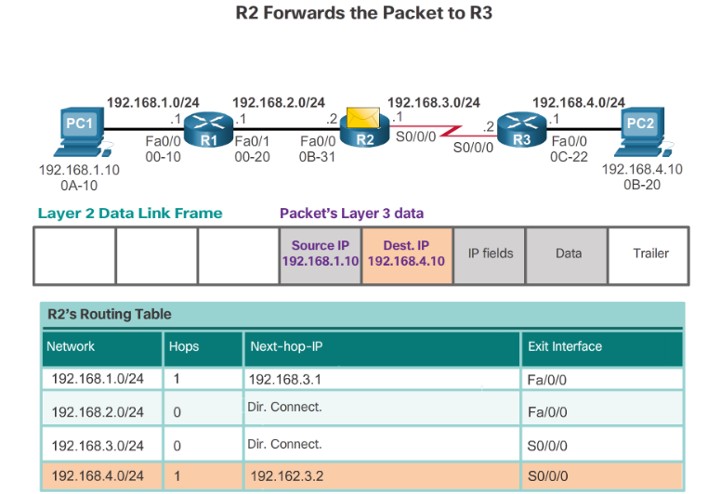
Switching Packets Between Networks
Packet Routing
Notes:
1.2 - Routing Decisions
1.2.1 – Switching Packets Between Networks
1.2.1.4 - Packet Routing

Slide 26
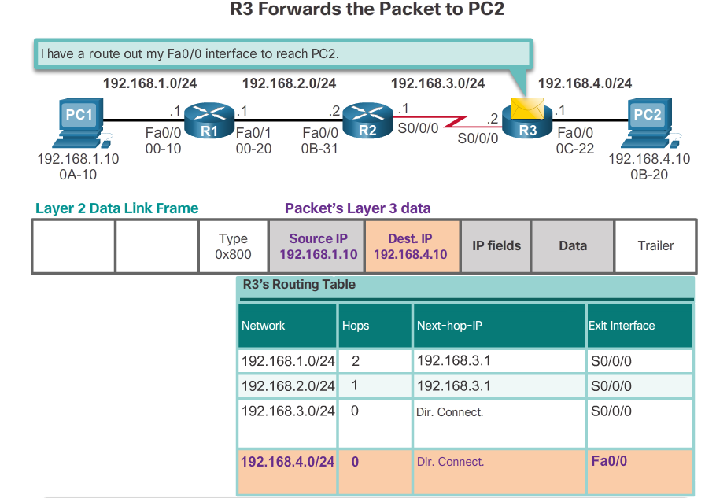
Switching Packets Between Networks
Reach the Destination
Notes:
1.2 - Routing Decisions
1.2.1 – Switching Packets Between Networks
1.2.1.5 - Reach the Destination

Slide 27
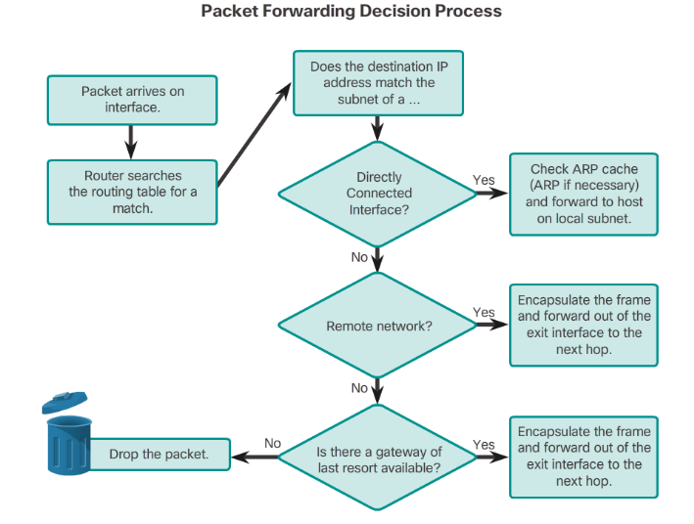
Path Determination
Routing Decisions
Notes:
1.2 - Routing Decisions
1.2.2 – Path Determination
1.2.2.1 - Routing Decisions

Slide 28
Path Determination
Best Path
Best path is selected by a routing protocol based on the value or metric it uses to determine the distance to reach a network:
  A metric is the value used to measure the distance to a given network.
  Best path to a network is the path with the lowest metric.
Dynamic routing protocols use their own rules and metrics to build and update routing tables:
  Routing Information Protocol (RIP) - Hop count
  Open Shortest Path First (OSPF) - Cost based on cumulative bandwidth from source to destination
  Enhanced Interior Gateway Routing Protocol (EIGRP) - Bandwidth, delay, load, reliability
Notes:
1.2 - Routing Decisions
1.2.2 – Path Determination
1.2.2.2 - Best Path

Slide 29
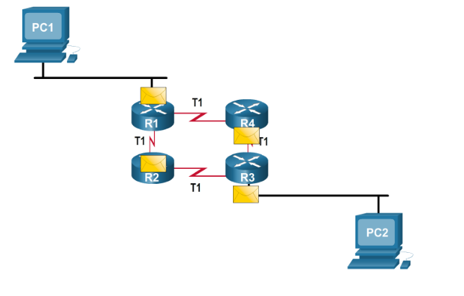
Path Determination
Load Balancing
When a router has two or more paths to a destination with equal cost metrics, then the router forwards the packets using both paths equally:
  Equal cost load balancing can improve network performance.
  Equal cost load balancing can be configured to use both dynamic routing protocols and static routes.
Notes:
1.2 - Routing Decisions
1.2.2 – Path Determination
1.2.2.3 - Load Balancing

Slide 30
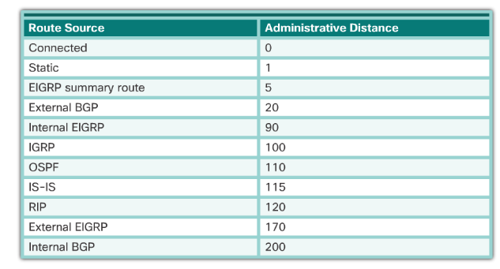
Path Determination
Administrative Distance
If multiple paths to a destination are configured on a router, the path installed in the routing table is the one with the lowest Administrative Distance (AD):
  A static route with an AD of 1 is more reliable than an EIGRP-discovered route with an AD of 90.
  A directly connected route with an AD of 0 is more reliable than a static route with an AD of 1.
Notes:
1.2 - Routing Decisions
1.2.2 – Path Determination
1.2.2.4 - Administrative Distance

Slide 31
1.3 Router Operation

Slide 32
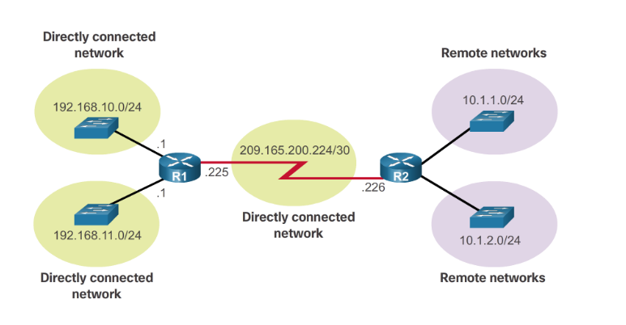
Analyze the Routing Table
The Routing Table
A routing table is a file stored in RAM that contains information about:
  Directly connected routes
  Remote routes
Notes:
1.3 – Router Operation
1.3.1 – Analyze the Routing Table
1.3.1.1 - The Routing Table

Slide 33
Analyze the Routing Table
Routing Table Sources
The show ip route command is used to display the contents of the routing table:
  Local route interfaces - Added to the routing table when an interface is configured. (displayed in IOS 15 or newer for IPv4 routes and all IOS releases for IPv6 routes.)
  Directly connected interfaces - Added to the routing table when an interface is configured and active.
  Static routes - Added when a route is manually configured and the exit interface is active.
  Dynamic routing protocol - Added when EIGRP or OSPF are implemented and networks are identified.
Notes:
1.3 – Router Operation
1.3.1 – Analyze the Routing Table
1.3.1.2 - Routing Table Sources

Slide 34
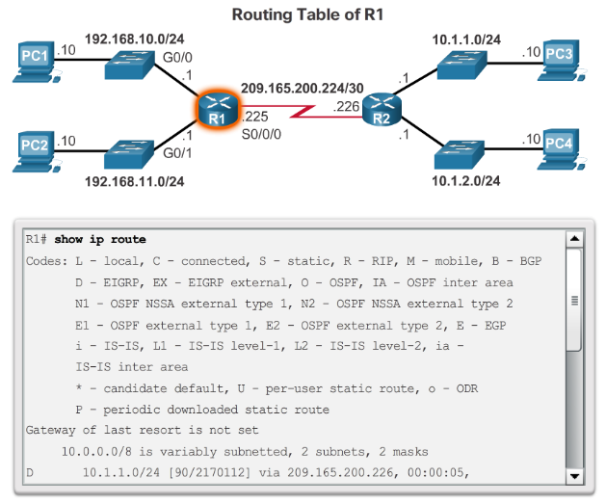
Analyze the Routing Table
Routing Table Sources (cont.)
Notes:
1.3 – Router Operation
1.3.1 – Analyze the Routing Table
1.3.1.2 - Routing Table Sources (cont.)

Slide 35
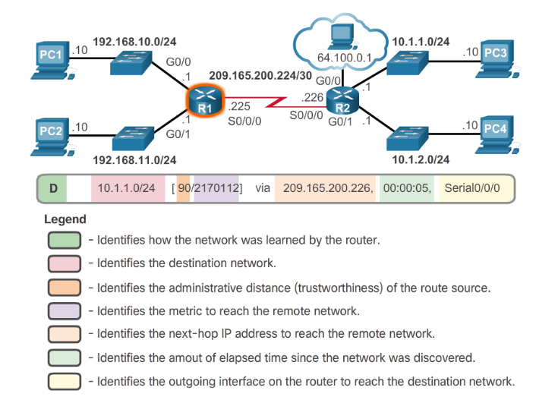
Analyze the Routing Table
Remote Network Routing Entries
Notes:
1.3 – Router Operation
1.3.1 – Analyze the Routing Table
1.3.1.3 - Remote Network Routing Entries

Slide 36
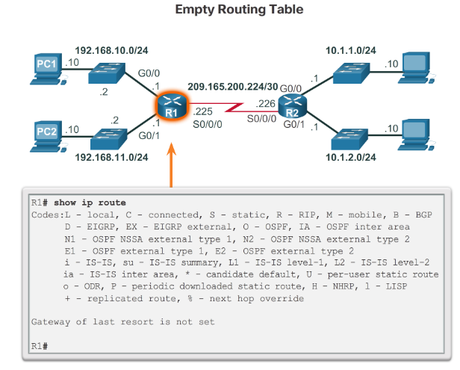
Directly Connected Routes
Directly Connected Interfaces
A newly deployed router, without any configured interfaces, has an empty routing table.
Notes:
1.3 – Router Operation
1.3.2 – Directly Connected Routes
1.3.2.1 - Directly Connected Interfaces

Slide 37
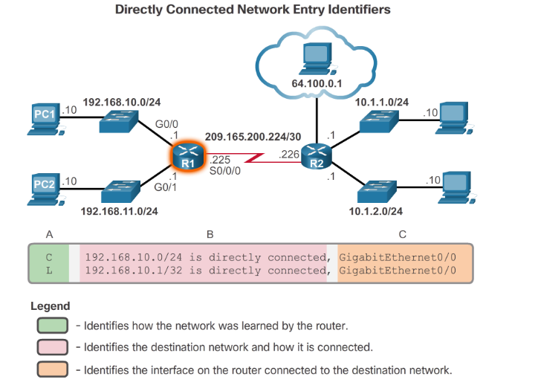
Directly Connected Routes
Directly Connected Routing Table Entries
Notes:
1.3 – Router Operation
1.3.2 – Directly Connected Routes
1.3.2.2 - Directly Connected Routing Table Entries

Slide 38
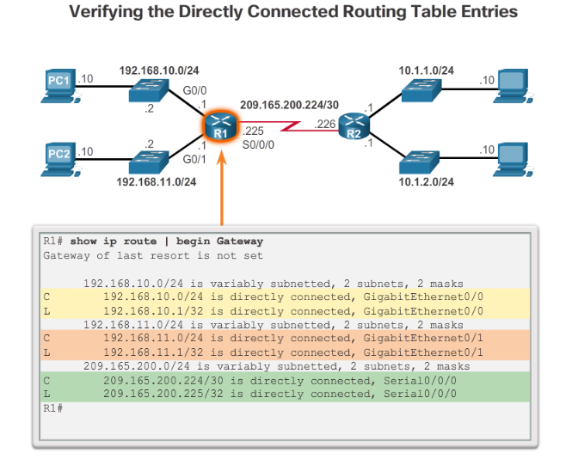
Directly Connected Routes
Directly Connected Example
Notes:
1.3 – Router Operation
1.3.2 – Directly Connected Routes
1.3.2.3 - Directly Connected Example

Slide 39
Statically Learned Routes
Static Routes
Static routes and default static routes can be implemented after directly connected interfaces are added to the routing table:
  Static routes are manually configured.
  They define an explicit path between two networking devices.
  Static routes must be manually updated if the topology changes.
  Their benefits include improved security and control of resources.
  Configure a static route to a specific network using the ip route network mask {next-hop-ip | exit-intf} command.
  A default static route is used when the routing table does not contain a path for a destination network.
  Configure a default static route using the ip route 0.0.0.0 0.0.0.0 {exit-intf | next-hop-ip} command.
Notes:
1.3 – Router Operation
1.3.3 - Statically Learned Routes
1.3.3.1 - Static Routes

Slide 40
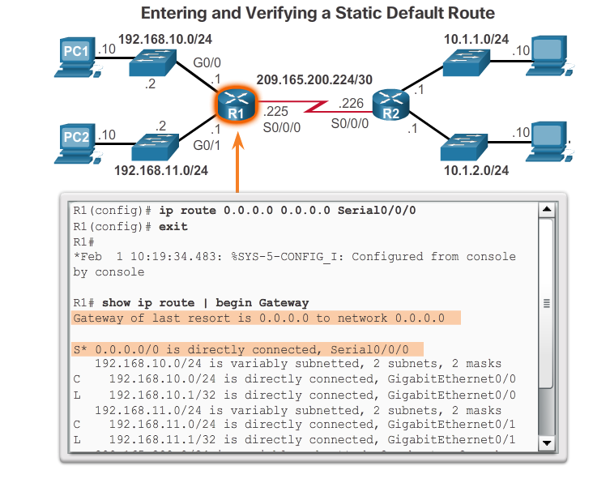
Statically Learned Routes
Static Route Example
Notes:
1.3 – Router Operation
1.3.3 - Statically Learned Routes
1.3.3.2 - Static Route Example

Slide 41
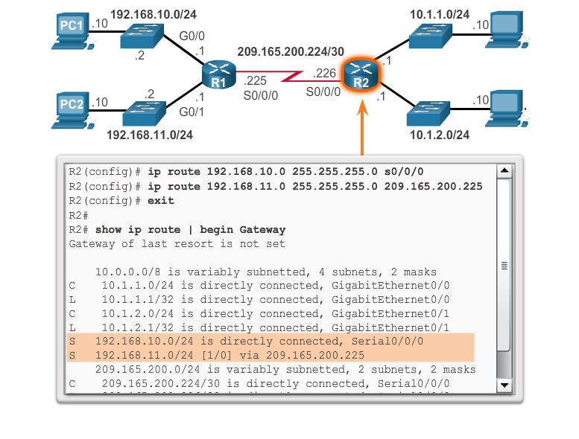
Statically Learned Routes
Static Route Example (cont.)
Entering and Verifying a Static Route
Notes:
1.3 – Router Operation
1.3.3 - Statically Learned Routes
1.3.3.2 - Static Route Example (cont.)

Slide 42
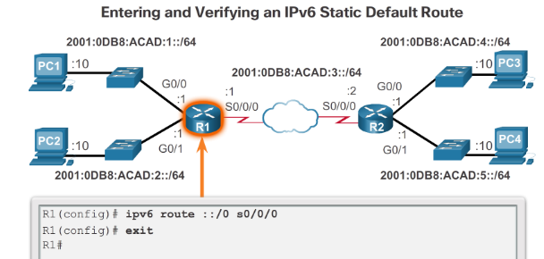
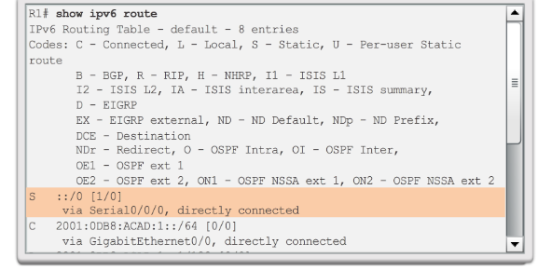
Statically Learned Routes
Static IPv6 Route Examples
Notes:
1.3 – Router Operation
1.3.3 - Statically Learned Routes
1.3.3.3 - Static IPv6 Route Examples

Slide 43
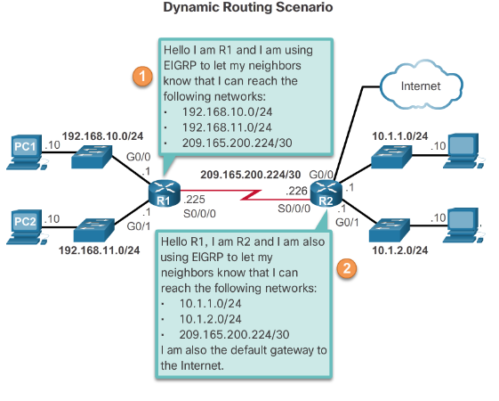
Dynamic Routing Protocols
Dynamic Routing
Dynamic routing is used by routers to share information about the reachability and status of remote networks.
It performs network discovery and maintains routing tables.
Routers have converged after they have finished exchanging and updating their routing tables.
Notes:
1.3 – Router Operation
1.3.4 – Dynamic Routing Protocols
1.3.4.1 - Dynamic Routing

Slide 44
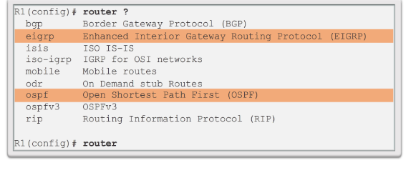
Dynamic Routing Protocols
IPv4 Routing Protocols
Cisco routers can support a variety of dynamic IPv4 routing protocols including:
  EIGRP – Enhanced Interior Gateway Routing Protocol
  OSPF – Open Shortest Path First
  IS-IS – Intermediate System-to-Intermediate System
  RIP – Routing Information Protocol
Use the router ? Command in global configuration mode to determine which routing protocols are supported by the IOS.
Notes:
1.3 – Router Operation
1.3.4 – Dynamic Routing Protocols
1.3.4.2 - IPv4 Routing Protocols

Slide 45
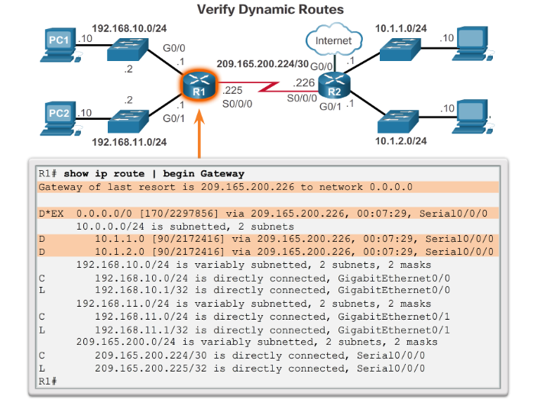
Dynamic Routing Protocols
IPv4 Dynamic Routing Examples
Notes:
1.3 – Router Operation
1.3.4 – Dynamic Routing Protocols
1.3.4.3 - IPv4 Dynamic Routing Examples

Slide 46


