Slide 1
Chapter 10: Device Discovery, Management, and Maintenance
Routing and Switching Essentials v6.0
Notes:
Cisco Networking Academy Program
Routing and Switching Essentials v6.0
Chapter 10: Device Discovery, Management, and Maintenance

Slide 2
Chapter 10 - Sections & Objectives
10.1 Device Discovery
  Use discovery protocols to map a network topology.
10.2 Device Management
  Configure NTP and Syslog in a small to medium-sized business network
10.3 Device Maintenance
  Maintain router and switch configuration and IOS files.
Notes:
2

Slide 3
10.1 Device Discovery
Notes:
Cisco Networking Academy Program
Routing and Switching Essentials v6.0
Chapter 10: Device Discovery, Management, and Maintenance

Slide 4

Device Discovery
Device Discovery with CDP
CDP Overview
  Cisco Discovery Protocol
  Neighbor discovery of physically connected Cisco devices
Configure and Verify CDP
  show cdp neighbors
  show cdp interface
  cdp run
  cdp enable
Discover Devices Using CDP
  Device identifiers - The host name of the neighbor device
  Port identifier - The name of the local and remote port
  Capabilities list - Whether the device is a router or a switch
  Platform - The hardware platform of the device
Notes:
10.1 - Device Discovery
10.1.1 - Device Discovery with CDP

Slide 5

Device Discovery
Device Discovery with LLDP
LLDP Overview
  A vendor neutral layer 2 neighbor discovery protocol, similar to CDP
Configure and Verify LLDP
  show lldp
  lldp run
  lldp transmit
  lldp receive
Discover Devices Using LLDP
  show lldp neighbors
Notes:
10.1 - Device Discovery
10.1.2 - Device Discovery with LLDP

Slide 6
10.2 Device Management
Notes:
Cisco Networking Academy Program
Routing and Switching Essentials v6.0
Chapter 10: Device Discovery, Management, and Maintenance

Slide 7
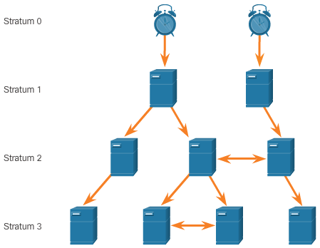

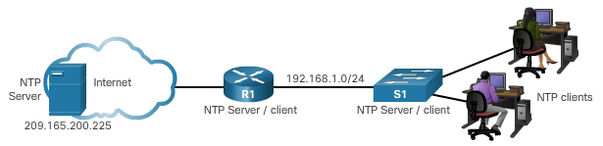
Device Management
Implement NTP
Setting the System Clock
  Manually configure the date and time
  Configure Network Time Protocol (NTP)
NTP Operation
  Hierarchical system of time sources
  Stratum 0 – Authoritative time source
  Stratum number indicates how far the server is from the time source
Configure and Verify NTP
  ntp server ip-address
  show ntp associations
  show ntp status
  show clock
Notes:
10.2 - Device Management
10.2.1 - Implement NTP

Slide 8
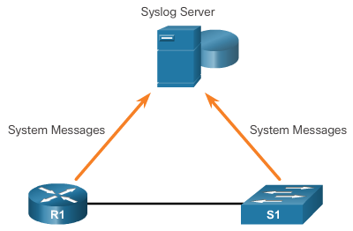
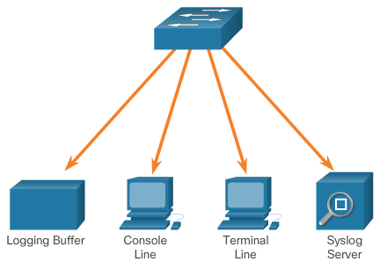
Device Management
Syslog Operation
Introduction to Syslog
  Allows devices to send their messages to syslog server
  Supported by most networking devices
  Primary functions:
    log information
    select the type
    specify the destinations
Syslog Message Format
  Severity level from 0 – 7
  Facility – service identifiers
Service Timestamp
  Enhances real-time debugging and management
  service timestamps log datetime
Notes:
10.2 - Device Management
10.2.2 – Syslog Operation

Slide 9
Device Management
Syslog Configuration
Syslog Server
  Parses the output and places the messages into pre-defined columns
  Timestamps are displayed if configured on networking devices that generated the log messages
  Allows the network administrators to navigate the large amount of data compiled on a syslog server.
Default Logging
  Send log messages of all severity level to the console
  show logging
Router and Switch Commands for Syslog Clients
  logging ip-address
  logging trap level
  logging source-interface source-interface interface-number
Verifying Syslog
  show logging
  Use the pipe (|) to limit the amount of displayed log messages
Notes:
10.2 - Device Management
10.2.3 – Syslog Configuration

Slide 10
10.3 Device Maintenance
Notes:
Cisco Networking Academy Program
Routing and Switching Essentials v6.0
Chapter 10: Device Discovery, Management, and Maintenance

Slide 11
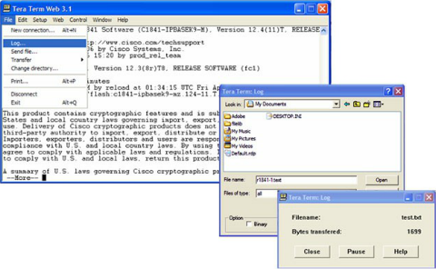
Device Maintenance
Router and Switch File Maintenance
Router and Switch File Systems
  show file systems – lists all available file system
  dir – lists the content of the file system
  pwd - verify the present working directory
  cd – changes the current directory
Backing up and Restoring using Text Files
Notes:
10.3 - Device Maintenance
10.3.1 – Router and Switch File Maintenance

Slide 12
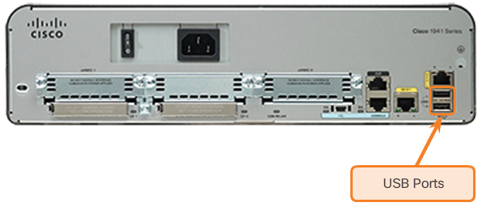
Device Maintenance
Router and Switch File Maintenance (Cont.)
Backing up and Restoring using TFTP
  copy running-config tftp
  copy startup-config tftp
Using USB Ports for Backing Up and Restoring
  show file systems
  dir usbflash0:
  copy run usbflash0:/
Password Recovery
  Enter ROMMON mode
  Change configuration register to 0x2142
  Make changes to the original startup config
  Save the new configuration
Notes:
10.3 - Device Maintenance
10.3.1 – Router and Switch File Maintenance (Cont.)

Slide 13
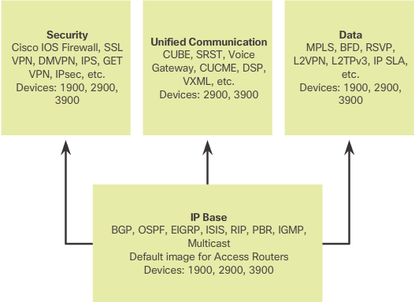
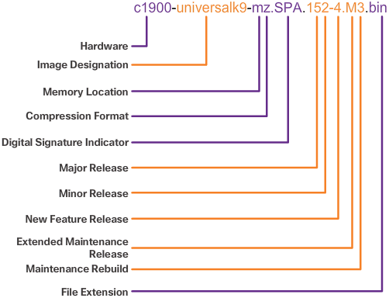
Device Maintenance
IOS System Files
IOS 15 System Image Packaging
  universalk9 images
  universalk9_npe images
  Technology packages: IP Base, Data, UC, SEC
  Data, UC, and SEC technology packages are activated through licensing
IOS Image Filenames
  Feature sets and version
  show flash
Notes:
10.3 - Device Maintenance
10.3.2 – IOS System Files

Slide 14
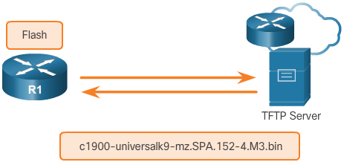
Device Maintenance
IOS Image Management
TFTP Servers as a Backup Location
  Backup location for IOS images and configuration files
Steps to Backup IOS Image to TFTP Server
  Verify access to TFTP server
  Verify sufficient disk space
  Copy the image to the TFTP server
    copy source-url tftp:
Steps to Copy an IOS Image to a Device
  Download IOS image from Cisco.com and transfer it to TFTP server
  Verify access to TFTP server from device
  Verify sufficient disk space on device
  Copy the image from the TFTP server
    copy tftp: destination-url
The boot system Command
  Command to load the new image during bootup
  boot system file-url
Notes:
10.3 - Device Maintenance
10.3.3 – IOS Image Management

Slide 15
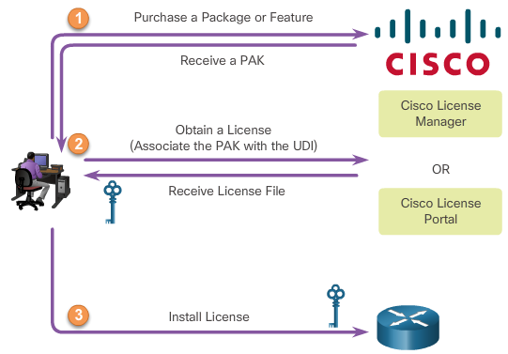
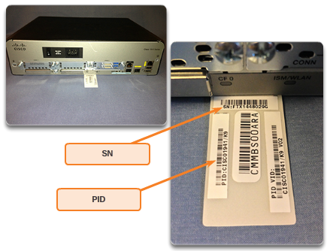
Device Maintenance
Software Licensing
Licensing Process
  Purchase the software package or feature to install
  Obtain a license
    Cisco License Manger
    Cisco License Portal
    Requires PAK number and UDI
      show license udi
  Install the license
    license install stored-location-url
    reload
Notes:
10.3 - Device Maintenance
10.3.4 – Software Licensing

Slide 16
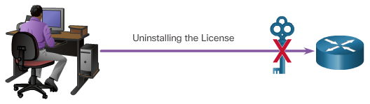
Device Maintenance
License Verification and Management
License verification
  show version
  show license
Activate an evaluation right-to-use license
  license accept end user agreement
  license boot module module-name technology-package package-name
Back up the license
  license save file-sys://lic-location
Uninstall the license
  Disable the license
    license boot module module-name technology-package package-name disable
  Clear the license
    license clear feature-name
    no license boot module module-name technology-package package-name disable
Notes:
10.3 - Device Maintenance
10.3.5 – License Verification and Management

Slide 17
10.4 Chapter Summary
Notes:
Cisco Networking Academy Program
Routing and Switching Essentials v6.0
Chapter 10: Device Discovery, Management, and Maintenance

Slide 18
Chapter Summary
Summary
CDP is a Cisco proprietary protocol for network discovery on the data link layer. It can share information, such as device names and IOS versions, with other physically connected Cisco devices.
LLDP is vendor-neutral protocol used on the data link layer for network discovery. The network devices advertise information, such as their identities and capabilities, to their neighbors.
NTP synchronizes the time of day among a set of distributed time servers and clients. This allows networking devices to agree on the time a specific event occurred, such as the loss of connectivity between a router and a switch.
Syslog messages can be trapped and sent to a syslog server where the network administrator can investigate when the link failed.
Device maintenance includes the tasks of backing up, restoring, and upgrading IOS images and configuration files from an TFTP server or using USB storage devices.
Upgrading an IOS image also includes tasks related to software licensing.
Understanding IOS image name conventions can be useful in the determination of included IOS feature sets.
Notes:
10.4.1.1 - Summary

