Slide 1
Chapter 2: Static Routing
Routing and Switching Essentials v6.0
Notes:
Cisco Networking Academy Program
Routing and Switching Essentials v6.0
Chapter 2: Static Routing

Slide 2
Chapter 2 - Sections & Objectives
2.1 Static Routing Implementation
Explain the advantages and disadvantages of static routing.
Explain the purpose of different types of static routes.
2.2 Configure Static and Default Routes
Configure IPv4 and IPv6 static routes by specifying a next-hop address.
Configure IPv4 and IPv6 default routes.
Configure a floating static route to provide a backup connection.
Configure IPv4 and IPv6 static host routes that direct traffic to a specific host
2.3 Troubleshoot Static and Default Route Issues
Explain how a router processes packets when a static route is configured.
Troubleshoot common static and default route configuration issues.
Notes:
2

Slide 3
2.1 Static Routing Implementation
Notes:
Cisco Networking Academy Program
Routing and Switching Essentials v6.0
Chapter 2: Static Routing

Slide 4
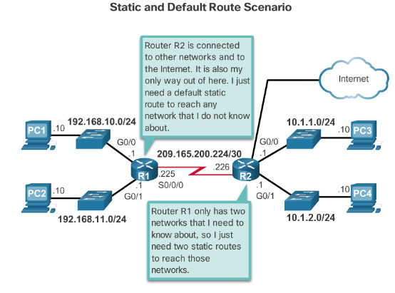
Static Routing Reach Remote Networks
A router can learn about remote networks in one of two ways:
Manually - Remote networks are manually entered into the route table using static routes.
Dynamically - Remote routes are automatically learned using a dynamic routing protocol.
Notes:
2.1 – Static Routing
2.1.1.1 – Reach Remote Networks

Slide 5
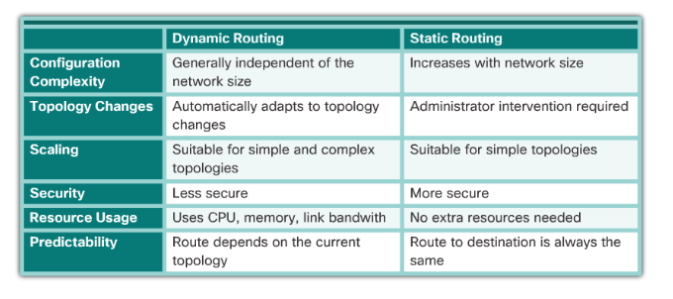
Static Routing Why Use Static Routing?
Static routing provides some advantages over dynamic routing, including:
Static routes are not advertised over the network, resulting in better security.
Static routes use less bandwidth than dynamic routing protocols, no CPU cycles are used to calculate and communicate routes.
The path a static route uses to send data is known.
Notes:
2.1.1.2 – Why Use Static Routing?

Slide 6
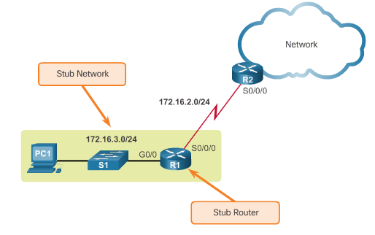
Static Routing When to Use Static Routes
Static routing has three primary uses:
Providing ease of routing table maintenance in smaller networks.
Routing to and from stub networks. A stub network is a network accessed by a single route, and the router has no other neighbors.
Using a single default route to represent a path to any network that does not have a more specific match with another route in the routing table.
Notes:
2.1.1.3 – When to Use Static Routes

Slide 7
Types of Static Routes Static Route Applications
Static Routes are often used to:
Connect to a specific network.
Provide a Gateway of Last Resort for a stub network.
Reduce the number of routes advertised by summarizing several contiguous networks as one static route.
Create a backup route in case a primary route link fails.
Notes:
2.1.2 - Types of Static Routes
2.1.2.1 – Static Route Applications

Slide 8
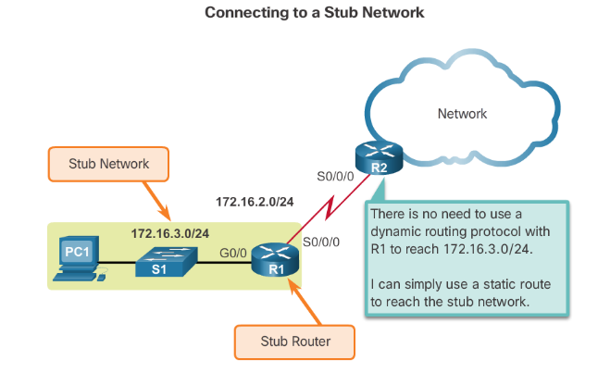
Types of Static Routes Standard Static Route
Notes:
2.1.2.2 Standard Static Route

Slide 9
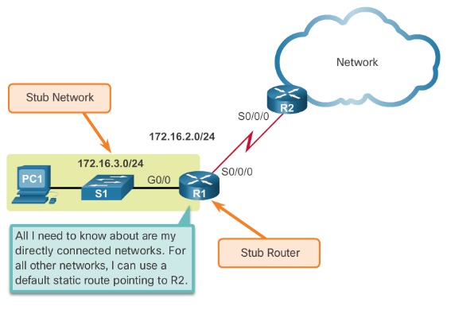
Types of Static Routes Default Static Route
A default static route is a route that matches all packets.
A default route identifies the gateway IP address to which the router sends all IP packets that it does not have a learned or static route.
A default static route is simply a static route with 0.0.0.0/0 as the destination IPv4 address.
Notes:
2.1.2.3 Default Static Route

Slide 10
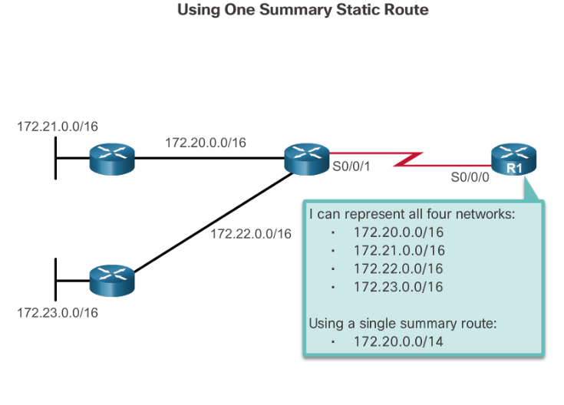
Types of Static Routes Summary Static Route
Notes:
2.1.2.4 Summary Static Route

Slide 11
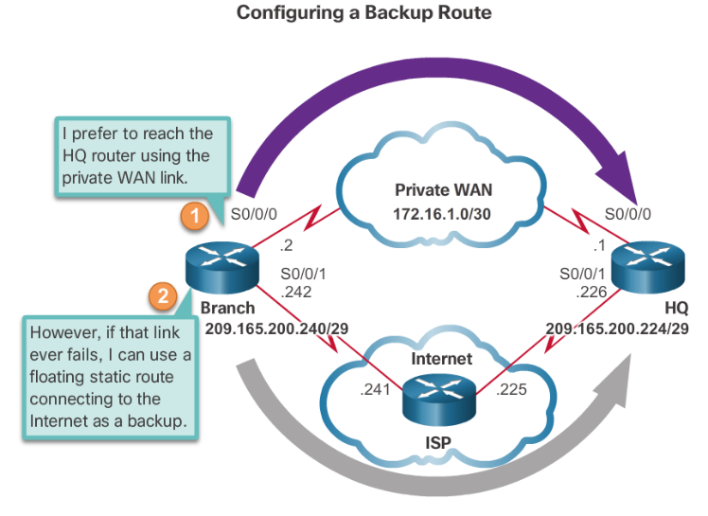
Types of Static Routes Floating Static Route
Notes:
2.1.2.5 Floating Static Route

Slide 12
6.2 Configure Static and Default Routes
Notes:
Cisco Networking Academy Program
Routing and Switching Essentials v6.0
Chapter 2: Static Routing

Slide 13
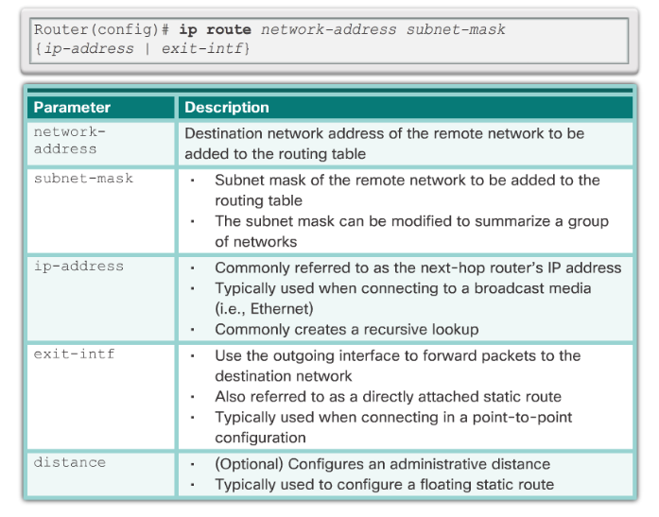
Configure IPv4 Static Routes ip route Command
Notes:
2.2 Configure Static and Default Routes
2.2.1.1 ip route Command

Slide 14
Configure IPv4 Static Routes Next-Hop Options
The next hop can be identified by an IP address, exit interface, or both. How the destination is specified creates one of the three following route types:
Next-hop route - Only the next-hop IP address is specified.
Directly connected static route - Only the router exit interface is specified.
Fully specified static route - The next-hop IP address and exit interface are specified.
Notes:
2.2.1.2 Next-Hop Options

Slide 15
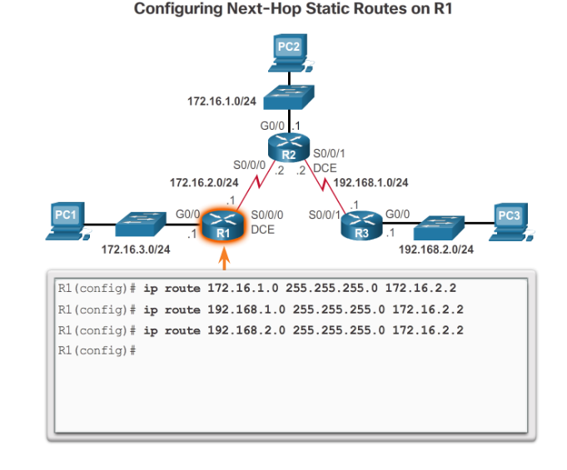
Configure IPv4 Static Routes Configure a Next-Hop Static Route
Notes:
2.2.1.3 Configure a Next-Hop Static Route

Slide 16
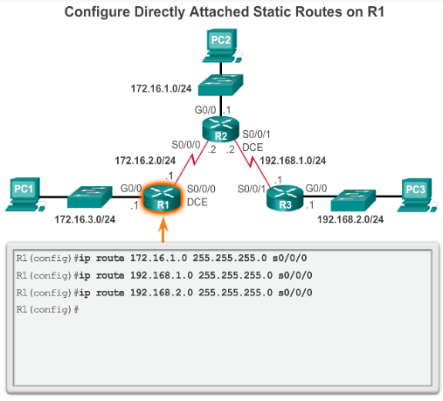
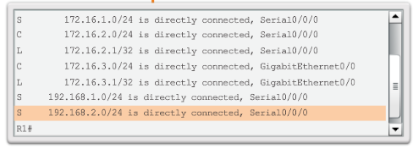
Configure IPv4 Static Routes Configure Directly Connected Static Route
Notes:
2.2.1.4 Configure a Directly Connected Static Route

Slide 17
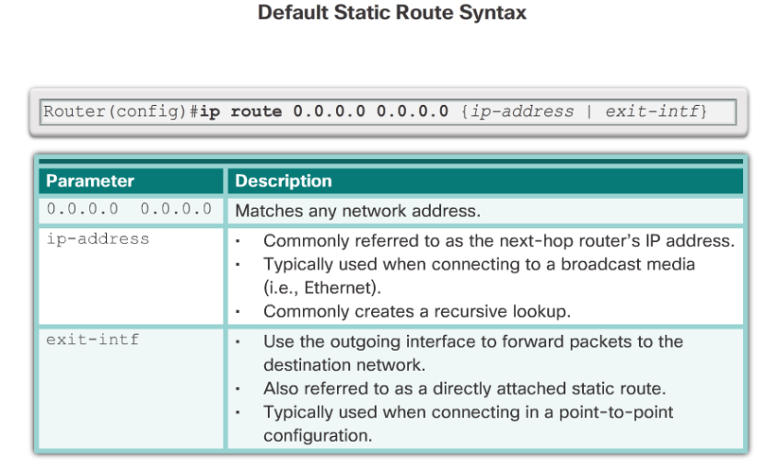
Configure IPv4 Static Routes Default Static Route
Notes:
2.2.2.1 Default Static Route

Slide 18
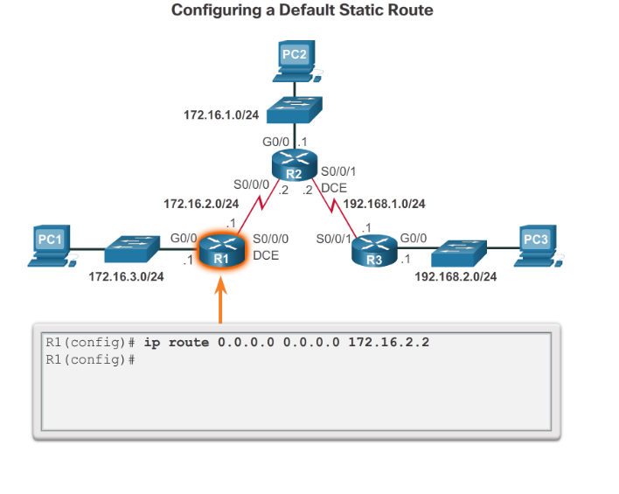
Configure IPv4 Static Routes Configure a Default Static Route
Notes:
2.2.2.2 Configure a Default Static Route

Slide 19
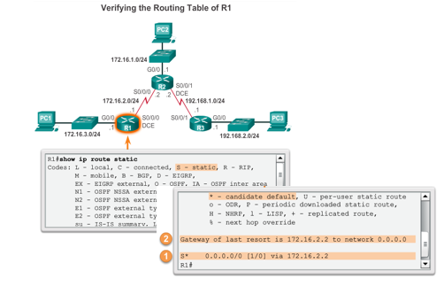
Configure IPv4 Static Routes Verify a Default Static Route
Verify a Default Static Route
Verify a Default Static Route
Notes:
2.2.2.3 Verify a Default Static Route

Slide 20
Configure IPv6 Static Routes Next-Hop Options
Verify a Default Static Route
Verify a Default Static Route
Next-hop static IPv6 route - Only the next-hop IPv6 address is specified
Directly connected static IPv6 route - Only the router exit interface is specified
Fully specified static IPv6 route - The next-hop IPv6 address and exit interface are specified
Notes:
2.2.3.2 Next-Hop Options

Slide 21
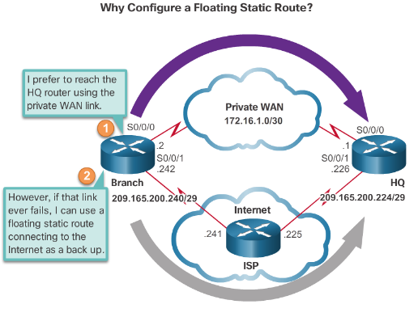
Configure IPv6 Default Routes Floating Static Routes
Verify a Default Static Route
Verify a Default Static Route
Floating static routes have an administrative distance greater than the administrative distance of another static route or dynamic routes.
The static route “floats” and is not used when the route with the better administrative distance is active.
If the preferred route is lost the floating static route can take over.
Notes:
2.2.5.1 Floating Static Routes

Slide 22
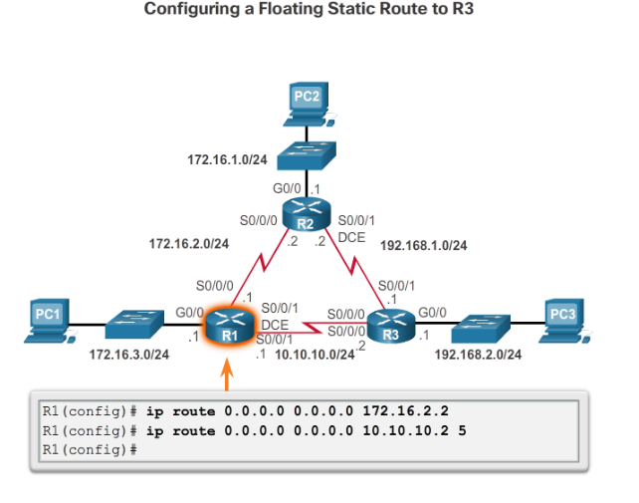
Configure IPv6 Default Routes Configure an IPv4 Floating Static Route
Verify a Default Static Route
Verify a Default Static Route
Notes:
2.2.5.2 Configure an IPv4 Floating Static Route

Slide 23
Configure IPv6 Default Routes Test the IPv4 Floating Static Route
Verify a Default Static Route
Verify a Default Static Route
To test a floating static route:
Use the show ip route command to verify that the routing table is using the default static route.
Use the traceroute command to follow the traffic flow out the primary route.
Disconnect the link or shutdown the primary interface(s). In the curriculum example the serial interfaces on R2 are shutdown.
Use a show ip route command to verify that the routing table is using the floating static route.
Use a traceroute command to follow the traffic flow out the backup route.
Notes:
2.2.5.3 Test the IPv4 Floating Static Route

Slide 24
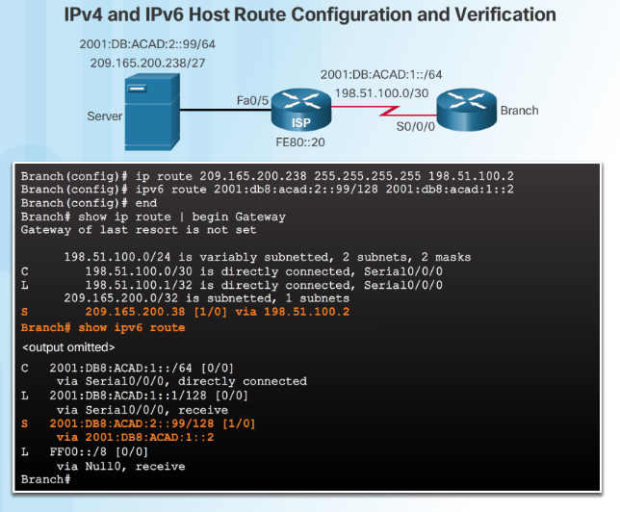
Configure Static Host Routes Configure IPv4 and IPv6 Static Host Routes
Verify a Default Static Route
Verify a Default Static Route
Notes:
2.2.6.3 Configure IPv4 and IPv6 Static Host Routes

Slide 25
6.2 Troubleshoot Static and Default Route Issues
Notes:
Cisco Networking Academy Program
Routing and Switching Essentials v6.0
Chapter 2: Static Routing

Slide 26
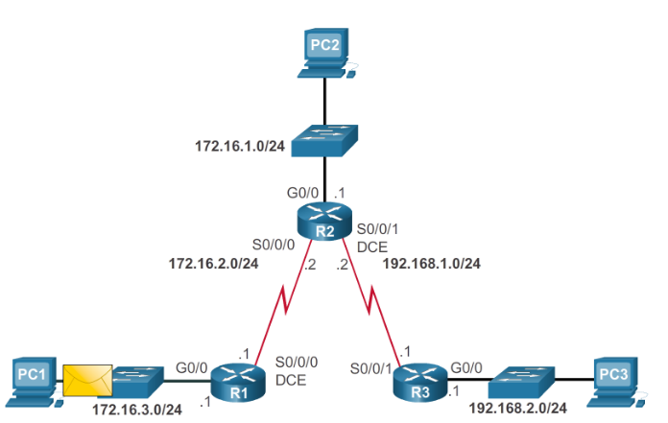
Packet Processing with Static Routes Static Routes and Packet Forwarding
Verify a Default Static Route
Notes:
2.3.1.1 Static Routes and Packet Forwarding

Slide 27
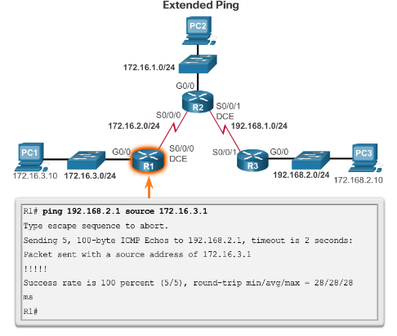
Troubleshoot IPv4 Static and Default Route Configuration Troubleshoot a Missing Route
Verify a Default Static Route
IOS troubleshooting commands include:
ping
Extended ping enables you to specify the source IP address for the ping packets.
traceroute
show ip route
show ip interface brief
show cdp neighbors detail
Notes:
2.3.2.1 Troubleshoot a Missing Route

Slide 28
Packet Processing with Static Routes Solve a Connectivity Problem
Verify a Default Static Route
Finding a missing (or misconfigured) route requires using the right tools in a methodical manner.
Use the ping command to confirm the destination can’t be reached.
A traceroute would also reveal the closest router (or hop) that fails to respond as expected. In this case, the router would then send an Internet Control Message Protocol (ICMP) destination unreachable message back to the source.
The next step is to investigate the routing table using the show ip route command. Look for missing or misconfigured routes.
Incorrect static routes are a common cause of routing problems.
Notes:
2.3.2.2 Solve a Connectivity Problem

Slide 29


