Slide 1
Chapter 3:
Dynamic Routing
Notes:
Cisco Networking Academy Program
Routing and Switching Essentials v6.0
Chapter 3: Dynamic Routing

Slide 2
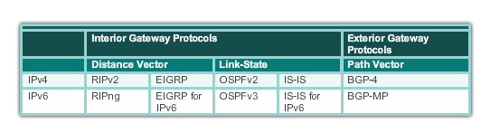
Dynamic Routing Protocol Overview
Dynamic Routing Protocol Evolution
Dynamic routing protocols have been used in networks since the late 1980s.
Newer versions support the communication based on IPv6.
Routing Protocols Classification
Notes:
3.1 – Dynamic Routing Protocols
3.1.1 – Dynamic Routing Protocol Overview
3.1.1.1 – Dynamic Routing Protocol Evolution

Slide 3
Dynamic Routing Protocol Overview
Dynamic Routing Protocols Components
Routing Protocols are used to facilitate the exchange of routing information between routers.
The purpose of dynamic routing protocols includes:
Discovery of remote networks
Maintaining up-to-date routing information
Choosing the best path to destination networks
Ability to find a new best path if the current path is no longer available
Notes:
3.1 – Dynamic Routing Protocols
3.1.1 – Dynamic Routing Protocol Overview
3.1.1.2 - Dynamic Routing Protocols Components

Slide 4
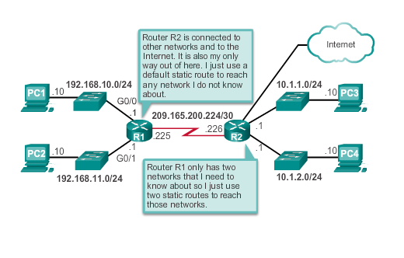
Dynamic verses Static Routing
Static Routing Uses (cont.)
Notes:
3.1 – Dynamic Routing Protocols
3.1.2 – Dynamic verses Static Routing
3.1.2.1 - Static Routing Uses (cont.)

Slide 5
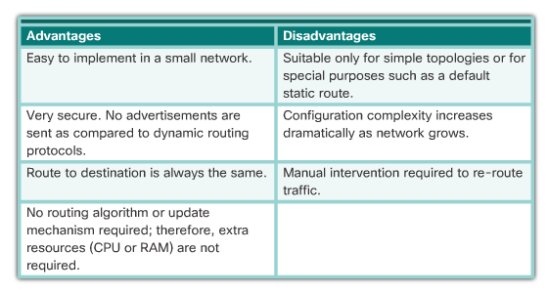
Dynamic verses Static Routing
Static Routing Advantages and Disadvantages
Notes:
3.1 – Dynamic Routing Protocols
3.1.2 – Dynamic verses Static Routing
3.1.2.2 - Static Routing Advantages and Disadvantages

Slide 6
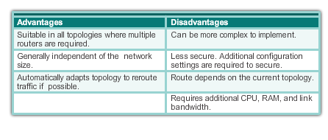
Dynamic verses Static Routing
Dynamic Routing Advantages & Disadvantages
Notes:
3.1 – Dynamic Routing Protocols
3.1.2 – Dynamic verses Static Routing
3.1.2.4 – Dynamic Routing Advantages and Disadvantages

Slide 7
3.2 RIPv2
Notes:
Cisco Networking Academy Program
Routing and Switching Essentials v6.0
Chapter 3: Dynamic Routing

Slide 8
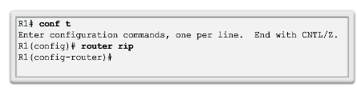
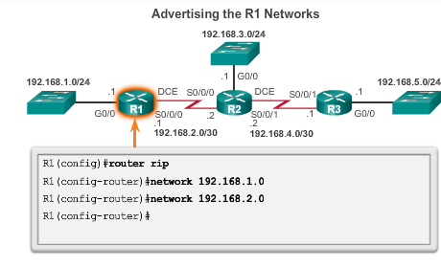
Configuring the RIP Protocol
Router RIP Configuration Mode
Notes:
3.2 – RIPv2
3.2.1 – Configuring the RIP Protocol
3.2.1.1 – Router RIP Configuration Modes

Slide 9
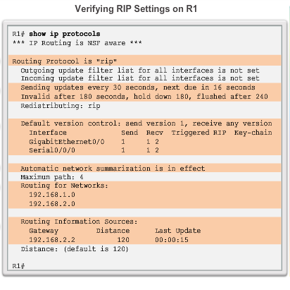
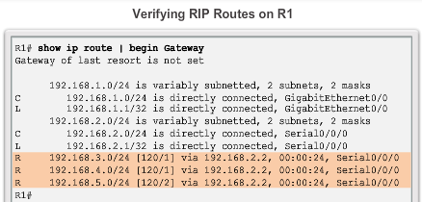
Configuring the RIP Protocol
Verify RIP Routing
Notes:
3.2 – RIPv2
3.2.1 – Configuring the RIP Protocol
3.2.1.3 – Verify RIP Routing

Slide 10
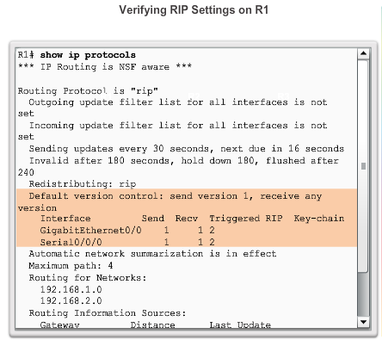
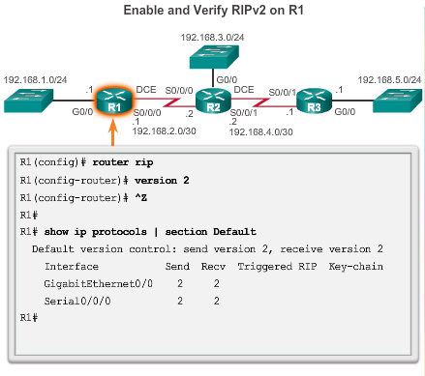
Configuring the RIP Protocol
Enable and Verify RIPv2
Notes:
3.2 – RIPv2
3.2.1 – Configuring the RIP Protocol
3.2.1.4 – Enable and Verify RIPv2

Slide 11
Configuring the RIP Protocol
Disable Auto Summarization
Similarly to RIPv1, RIPv2 automatically summarizes networks at major network boundaries by default.
To modify the default RIPv2 behavior of automatic summarization, use the no auto-summary router configuration mode command.
This command has no effect when using RIPv1.
When automatic summarization has been disabled, RIPv2 no longer summarizes networks to their classful address at boundary routers. RIPv2 now includes all subnets and their appropriate masks in its routing updates.
The show ip protocols now states that automatic network summarization is not in effect.
Notes:
3.2 – RIPv2
3.2.1 – Configuring the RIP Protocol
3.2.1.5– Disable Automatic Summarization

Slide 12
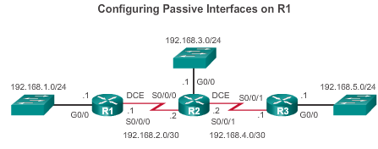
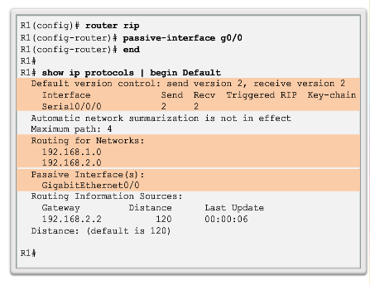
Configuring the RIP Protocol
Configuring Passive Interfaces
Sending out unneeded updates on a LAN impacts the network in three ways:
Wasted Bandwidth
Wasted Resources
Security Risk
Notes:
3.2 – RIPv2
3.2.1 – Configuring the RIP Protocol
3.2.1.6 – Configuring Passive Interfaces

Slide 13
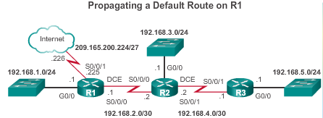
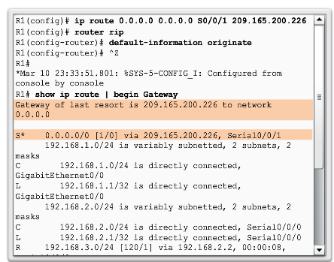
Configuring the RIP Protocol
Propagate a Default Route
Notes:
3.2 – RIPv2
3.2.1 – Configuring the RIP Protocol
3.2.1.7– Propagate a Default Route

Slide 14
3.3 The Routing Table
Notes:
Cisco Networking Academy Program
Routing and Switching Essentials v6.0
Chapter 3: Dynamic Routing

Slide 15
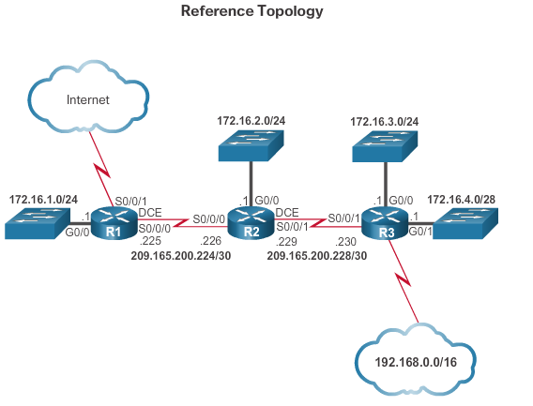
Parts of an IPv4 Route Entry
Routing Table Entries
Notes:
3.3 – The Routing Table
3.3.1 – Parts of an IPv4 Route Entry
3.3.1.1 –Routing Table Entries

Slide 16
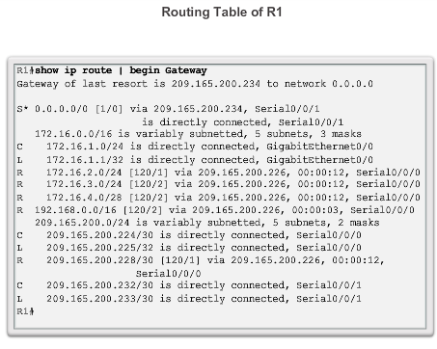
Parts of an IPv4 Route Entry
Routing Table Entries
Notes:
3.3 – The Routing Table
3.3.1 – Parts of an IPv4 Route Entry
3.3.1.1 –Routing Table Entries

Slide 17
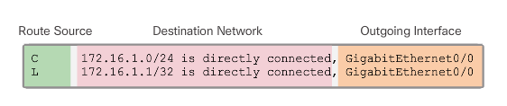
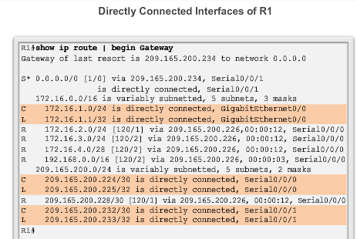
Parts of an IPv4 Route Entry
Directly Connected Entries
Notes:
3.3 – The Routing Table
3.3.1 – Parts of an IPv4 Route Entry
3.3.1.2 –Directly Connected Entries

Slide 18
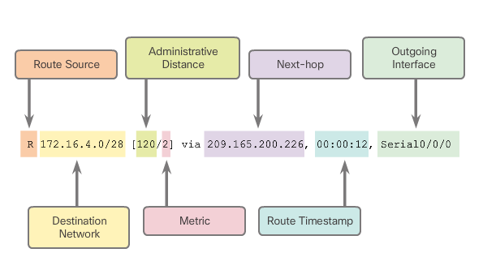
Parts of an IPv4 Route Entry
Remote Network Entries
Notes:
3.3 – The Routing Table
3.3.1 – Parts of an IPv4 Route Entry
3.3.1.3 – Remote Network Entries

Slide 19
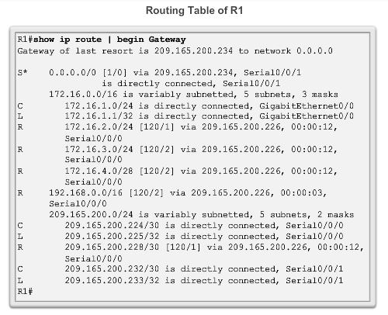
Dynamically Learned IPv4 Routes
Routing Table Terms
Routes are discussed
in terms of:
Ultimate route
Level 1 route
Level 1 parent route
Level 2 child routes
Notes:
3.3 – The Routing Table
3.3.2 – Dynamically Learned IPv4 Routes
3.3.2.1 – Routing Table Terms

Slide 20
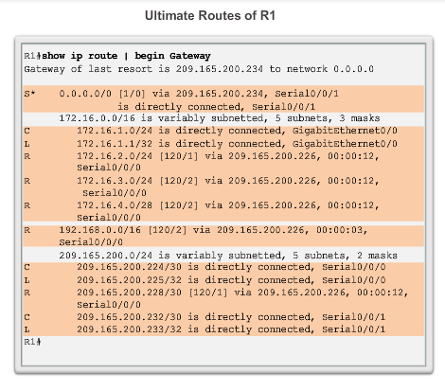
Dynamically Learned IPv4 Routes
Ultimate Route
An ultimate route is a routing table entry that contains either a next-hop IP address or an exit interface.
Directly connected, dynamically learned, and link local routes are ultimate routes.
Notes:
3.3 – The Routing Table
3.3.2 – Dynamically Learned IPv4 Routes
3.3.2.2 – Ultimate Route

Slide 21
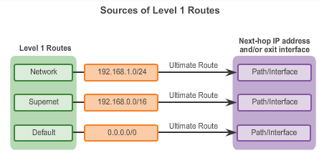
Dynamically Learned IPv4 Routes
Level 1 Route
Notes:
3.3 – The Routing Table
3.3.2 – Dynamically Learned IPv4 Routes
3.3.2.3 – Level 1 Route

Slide 22
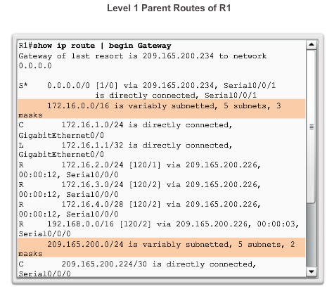
Dynamically Learned IPv4 Routes
Level 1 Parent Route
Notes:
3.3 – The Routing Table
3.3.2 – Dynamically Learned IPv4 Routes
3.3.2.4 – Level 1 Parent Route

Slide 23
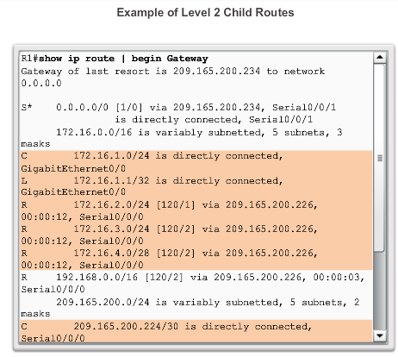
Dynamically Learned IPv4 Routes
Level 2 Child Route
Notes:
3.3 – The Routing Table
3.3.2 – Dynamically Learned IPv4 Routes
3.3.2.5– Level 2 Child Route

Slide 24
The IPv4 Route Lookup Process
Route Lookup Process
If the best match is a level 1 ultimate route, then this route is used to forward the packet.
If the best match is a level 1 parent route, proceed to the next step.
The router examines child routes (the subnet routes) of the parent route for a best match.
If there is a match with a level 2 child route, that subnet is used to forward the packet.
If there is not a match with any of the level 2 child routes, proceed to the next step.
Notes:
3.3 – The Routing Table
3.3.3 – The IPv4 Route Lookup Process
3.3.3.1 – Route Lookup Process

Slide 25
The Ipv4 Route Lookup Process
Route Lookup Process (cont.)
The router continues searching level 1 supernet routes in the routing table for a match, including the default route, if there is one.
If there is now a lesser match with a level 1 supernet or default routes, the router uses that route to forward the packet.
If there is not a match with any route in the routing table, the router drops the packet.
Notes:
3.3 – The Routing Table
3.3.3 – The IPv4 Route Lookup Process
3.3.3.1 – Route Lookup Process (cont.)

Slide 26
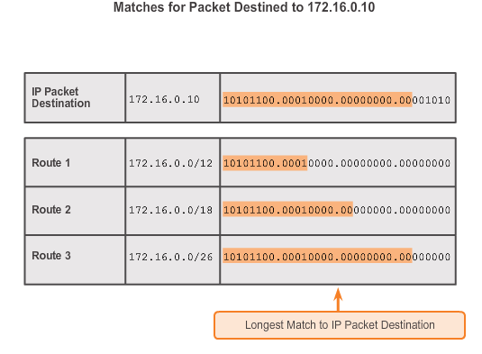
The IPv4 Route Lookup Process
Best Route = Longest Match
Notes:
3.3 – The Routing Table
3.3.3 – The IPv4 Route Lookup Process
3.3.3.2 – Best Route = Longest Match

