Slide 1
Chapter 4: Switched Networks
Notes:
Cisco Networking Academy Program
Routing & Switching Essentials v6.0
Chapter 4: Introduction to Switched Networks

Slide 2
4.1 LAN Design
Notes:
Cisco Networking Academy Program
Routing and Switching Essentials v6.0
Chapter 4: LAN Design

Slide 3
Switching Domains Broadcast Domains
A broadcast domain is the extent of the network where a broadcast frame can be heard.
Switches forward broadcast frames to all ports; therefore, switches do not break broadcast domains.
All ports of a switch, with its default configuration, belong to the same broadcast domain.
If two or more switches are connected, broadcasts are forwarded to all ports of all switches, except for the port that originally received the broadcast.
Notes:
4.2 – The Switched Environment
4.2.2 – Switching Domains
4.2.2.2 – Broadcast Domains

Slide 4
Switching Domains Alleviating Network Congestion
Switches help alleviate network congestion by:
Facilitating the segmentation of a LAN into separate collision domains.
Providing full-duplex communication between devices.
Taking advantage of their high-port density.
Buffering large frames.
Employing high-speed ports.
Taking advantage of their fast internal switching process.
Having a low, per-port cost.
Notes:
4.2 – The Switched Environment
4.2.2 – Switching Domains
4.2.2.3 – Alleviating Network Congestion

Slide 5
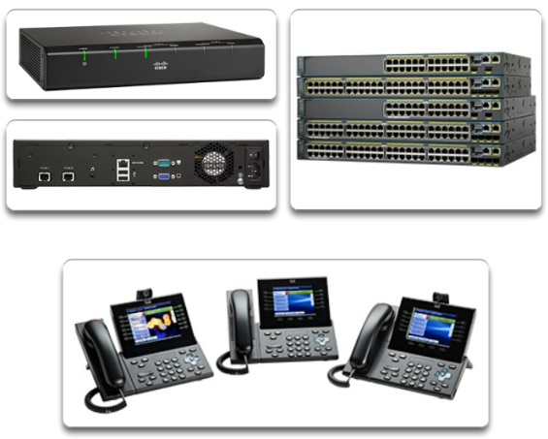
Converged Networks Growing Complexity of Networks
Our digital world is changing.
Information must be accessed from anywhere in the world.
Voice, Video, wireless, wired data, critical systems (servers) all ride on the same physical network gear (infrastructure).
Notes:
4.1 – LAN Design
4.1.1 – Converged Networks
4.1.1.1 – Growing Complexity of Networks

Slide 6
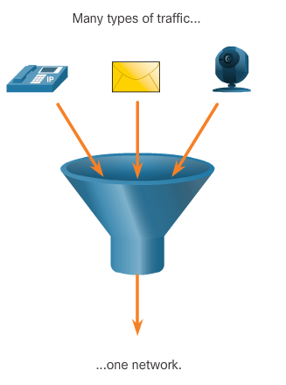
Converged Networks Elements of a Converged Network
To support collaboration, networks employ converged solutions.
Data services include voice systems, IP phones, voice gateways, video support, and video conferencing.
Call control, voice messaging, mobility, and automated attendant are also common features.
Multiple types of traffic; only one network to manage.
Substantial savings over installation and management of separate voice, video, and data networks.
Integrates IT management.
Notes:
4.1 – LAN Design
4.1.1 – Converged Networks
4.1.1.2 – Elements of a Converged Network

Slide 7
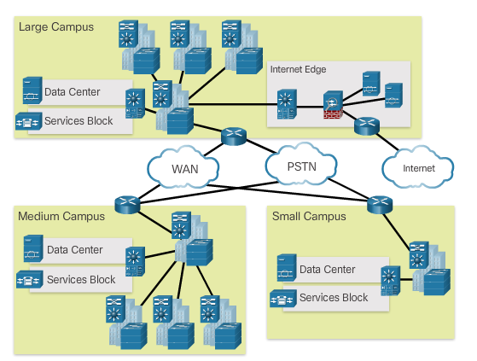
Converged Networks Cisco Borderless Networks
What is a network architecture that allows organizations to connect anyone, anywhere, anytime, and on any device securely, reliably, and seamlessly?
Notes:
4.1 – LAN Design
4.1.1 – Converged Networks
4.1.1.3 – Cisco Borderless Networks

Slide 8
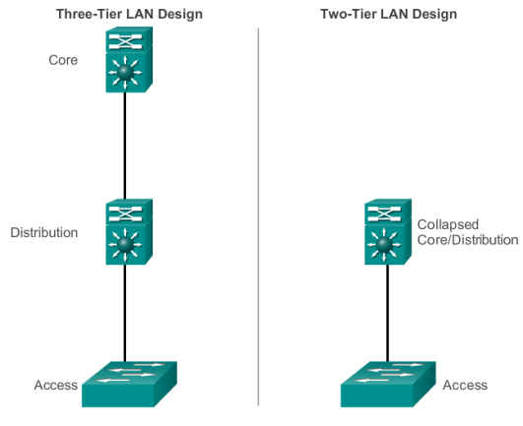
Converged Networks Hierarchy in the Borderless Switched Network
Borderless switched network design guidelines are built upon the following principles:
Hierarchical
Modularity
Resiliency
Flexibility
Notes:
4.1 – LAN Design
4.1.1 – Converged Networks
4.1.1.4 – Hierarchy in the Borderless Switched Network

Slide 9
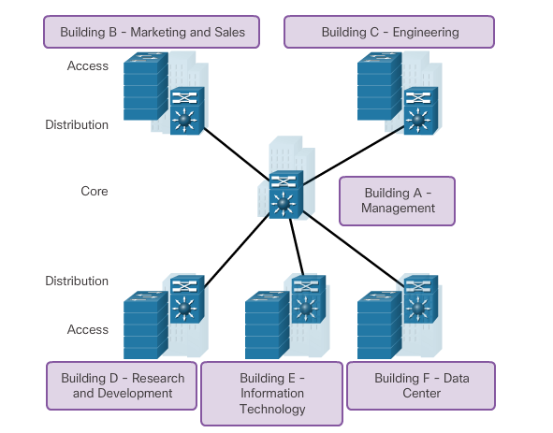
Converged Networks Access, Distribution, and Core Layers
Notes:
4.1 – LAN Design
4.1.1 – Converged Networks
4.1.1.5 – Access, Distribution, and Core Layers

Slide 10
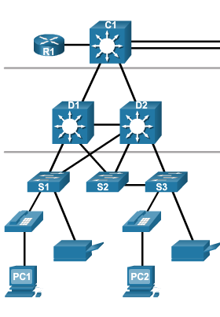
Switched Networks Role of Switched Networks
Switching technologies are crucial to network design.
Switching allows traffic to be sent only where it is needed in most cases, using fast methods.
A switched LAN:
Allows more flexibility
Allows more traffic management
Supports quality of service, additional security, wireless, IP telephony, and mobility services
Notes:
4.1 – LAN Design
4.1.2 – Switched Networks
4.1.2.1 – Role of Switched Networks

Slide 11
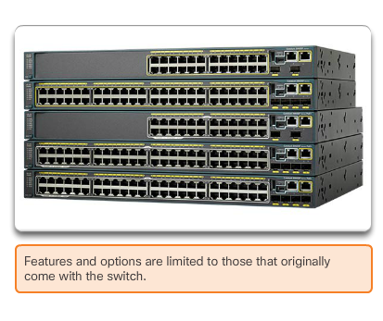
Switched Networks Form Factors
Fixed
Configuration
Switches
Notes:
4.1 – LAN Design
4.1.2 – Switched Networks
4.1.2.2 – Form Factors

Slide 12
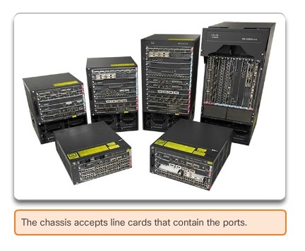
Switched Networks Form Factors
Modular
Platforms
Notes:
4.1 – LAN Design
4.1.2 – Switched Networks
4.1.2.2 – Form Factors

Slide 13
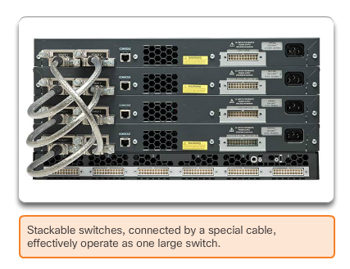
Switched Networks Form Factors
What are Stackable Switches?
Notes:
4.1 – LAN Design
4.1.2 – Switched Networks
4.1.2.2 – Form Factors

Slide 14
4.2 The Switched Environment
Notes:
Cisco Networking Academy Program
Routing and Switching Essentials v6.0
Chapter 4: Introduction to Switched Networks

Slide 15
Frame Forwarding Switching as a General Concept in Networking
A switch makes a decision based on ingress and a destination port.
A LAN switch keeps a table that it uses to determine how to forward traffic through the switch, aka the CAM table. Content Addressable Memory.
Cisco LAN switches forward Ethernet frames based on the destination MAC address of the frames.
Notes:
4.2 – The Switched Environment
4.2.1 – Frame Forwarding
4.2.1.1 - Switching as a General Concept in Networking and Telecommunications

Slide 16
Frame Forwarding Dynamically Populating a Switch MAC Table
A switch must first learn which devices exist on each port before it can transmit a frame.
As a switch learns the relationship of ports to devices, it builds a table called a MAC address or content addressable memory (CAM) table.
CAM is a special type of memory used in high-speed searching applications.
The information in the MAC address table is used to send frames.
When a switch receives an incoming frame with a MAC address that is not found in the CAM table, it floods it to all ports, except the one that received the frame.
Notes:
4.2 – The Switched Environment
4.2.1 – Frame Forwarding
4.2.1.2 - Dynamically Populating a Switch MAC Address Table

Slide 17
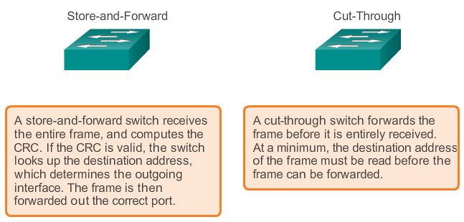
Frame Forwarding Switch Forwarding Methods
Notes:
4.2 – The Switched Environment
4.2.1 – Frame Forwarding
4.2.1.3 – Switch Forwarding Methods

Slide 18
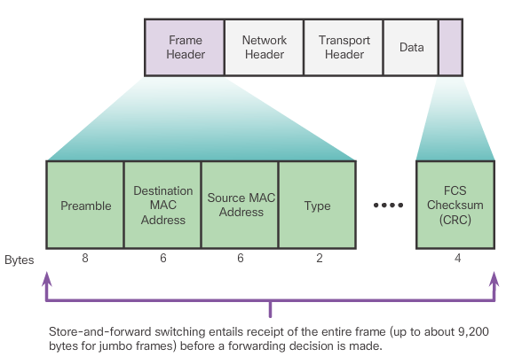
Frame Forwarding Store-and-Forward Switching
Allows the switch to:
Check for errors (via FCS check)
Perform automatic buffering
Slower forwarding process
Notes:
4.2 – The Switched Environment
4.2.1 – Frame Forwarding
4.2.1.4 - Store-and-Forward Switching

Slide 19
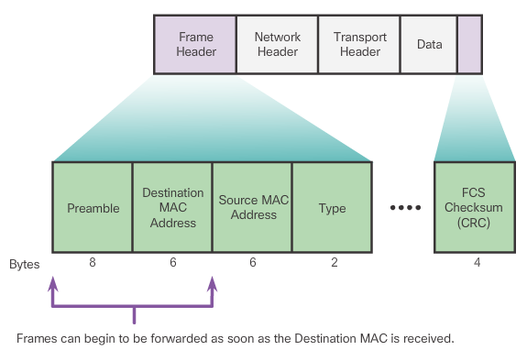
Frame Forwarding Cut-Through Switching
Allows the switch to start forwarding in about 10ms
No FCS check
No automatic buffering
Notes:
4.2 – The Switched Environment
4.2.1 – Frame Forwarding
4.2.1.5 – Cut-Through Switching

