Slide 1
Chapter 5:
Switch Configuration
Routing and Switching Essentials v6.0
Notes:
Cisco Networking Academy Program
Routing and Switching Essentials v6.0
Chapter 5: Switch Configuration

Slide 2
Chapter 5 - Sections & Objectives
5.1 Basic Switch Configuration
  Configure initial settings on a Cisco switch.
  Configure switch ports to meet network requirements.
5.2 Switch Security: Management and Implementation
  Configure the management virtual interface on a switch.
  Configure the port security feature to restrict network access.
Notes:
2

Slide 3
5.1 Basic Switch Configuration
Notes:
Cisco Networking Academy Program
Routing and Switching Essentials v6.0
Chapter 5: Switch Configuration

Slide 4
Configure a Switch with Initial Settings
Switch Boot Sequence
Power-on self test (POST).
Run boot loader software.
Boot loader performs low-level CPU initialization.
Boot loader initializes the flash file system.
Boot loader locates and loads a default IOS operating system software image into memory and passes control of the switch over to the IOS.
Notes:
5.1 – Basic Switch Configuration
5.1.1 – Configure a Switch with Initial Settings
5.1.1.1 Switch Boot Sequence

Slide 5
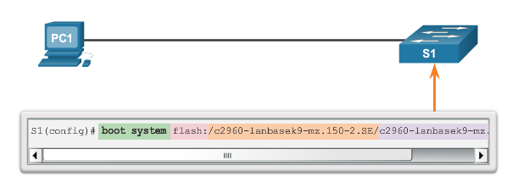
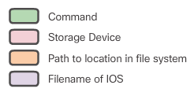
Configure a Switch with Initial Settings
Switch Boot Sequence (cont.)
To find a suitable Cisco IOS image, the switch goes through the following steps:
Step 1. It attempts to automatically boot by using information in the BOOT environment variable.
Step 2. If this variable is not set, the switch performs a top-to-bottom search through the flash file system. It loads and executes the first executable file, if it can.
Step 3. The IOS software then initializes the interfaces using the Cisco IOS commands found in the configuration file and startup configuration, which is stored in NVRAM.
Note: The boot system command can be used to set the BOOT environment variable. Use the show boot command to see to what the current IOS boot file is set.
Notes:
5.1 – Basic Switch Configuration
5.1.1 – Configure a Switch with Initial Settings
5.1.1.1 Switch Boot Sequence (cont.)

Slide 6
Configure a Switch with Initial Settings
Recovering From a System Crash
The boot loader can also be used to manage the switch if the IOS cannot be loaded.
The boot loader can be accessed through a console connection by:
  Connecting a PC by console cable to the switch console port. Unplug the switch power cord.
  Reconnecting the power cord to the switch and press and hold the Mode button.
  The System LED turns briefly amber and then solid green. Release the Mode button.
The boot loader switch: prompt appears in the terminal emulation software on the PC.
Notes:
5.1 – Basic Switch Configuration
5.1.1 – Configure a Switch with Initial Settings
5.1.1.2 – Recovering From a System Crash

Slide 7
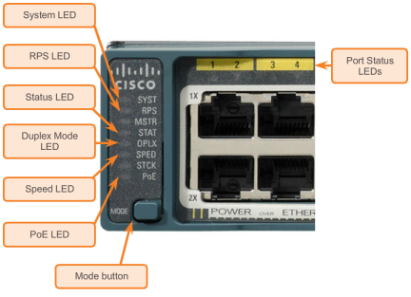
Configure a Switch with Initial Settings
Switch LED Indicators
Each port on Cisco Catalyst switches have status LED indicator lights.
By default, these LED lights reflect port activity, but they can also provide other information about the switch through the Mode button.
The following modes are available on Cisco Catalyst 2960 switches:
  System LED
  Redundant Power System (RPS) LED
  Port Status LED
  Port Duplex LED
  Port Speed LED
  Power over Ethernet (PoE) Mode LED
Notes:
5.1 – Basic Switch Configuration
5.1.1 – Configure a Switch with Initial Settings
5.1.1.3 - Switch LED Indicators

Slide 8
Configure a Switch with Initial Settings
Preparing for Basic Switch Management
To remotely manage a Cisco switch, it must be configured to access the network.
A console cable is used to connect a PC to the console port of a switch for configuration.
The IP information (address, subnet mask, gateway) is to be assigned to a switch virtual interface (SVI).
If managing the switch from a remote network, a default gateway must also be configured.
Although these IP settings allow remote management and remote access to the switch, they do not allow the switch to route Layer 3 packets.
Notes:
5.1 – Basic Switch Configuration
5.1.1 – Configure a Switch with Initial Settings
5.1.1.4 - Preparing for Basic Switch Management

Slide 9
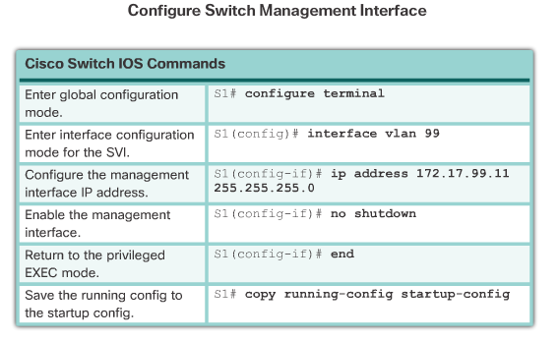
Configure a Switch with Initial Settings
Configuring Switch Management Access
Notes:
5.1 – Basic Switch Configuration
5.1.1 – Configure a Switch with Initial Settings
5.1.1.5 - Configuring Basic Switch Management Access with IPv4

Slide 10
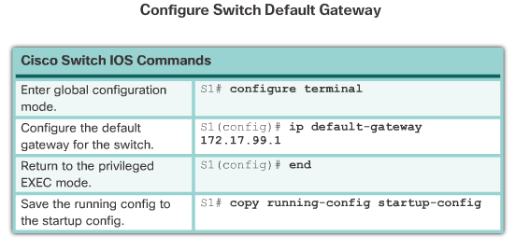
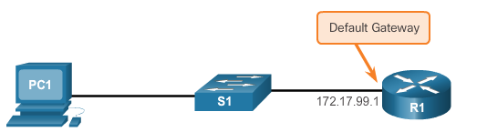
Configure a Switch with Initial Settings
Configuring Switch Management Access (cont.)
Notes:
5.1 – Basic Switch Configuration
5.1.1 – Configure a Switch with Initial Settings
5.1.1.5 - Configuring Basic Switch Management Access with IPv4 (cont.)

Slide 11
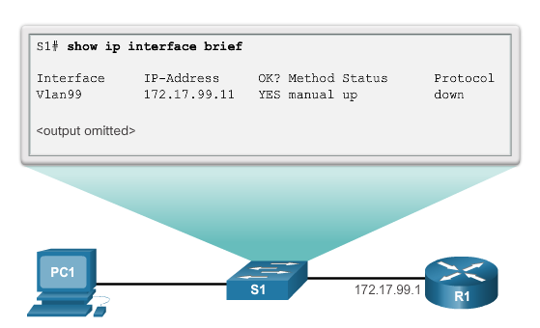
Configure a Switch with Initial Settings
Configuring Switch Management Access (cont.)
Notes:
5.1 – Basic Switch Configuration
5.1.1 – Configure a Switch with Initial Settings
5.1.1.5 - Configuring Basic Switch Management Access with IPv4 (cont.)

Slide 12
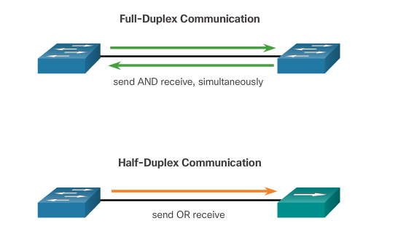
Configure Switch Ports
Duplex Communication
Notes:
5.1 – Basic Switch Configuration
5.1.2 – Configure Switch Ports
5.1.2.1 – Duplex Communication

Slide 13
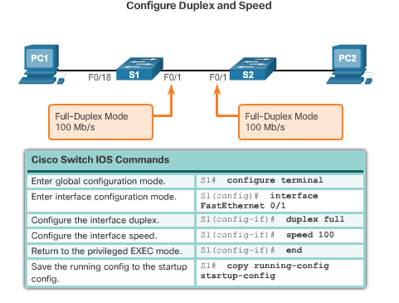
Configure Switch Ports
Configure Switch Ports at the Physical Layer
Notes:
5.1 – Basic Switch Configuration
5.1.2 – Configure Switch Ports
5.1.2.2 - Configure Switch Ports at the Physical Layer

Slide 14
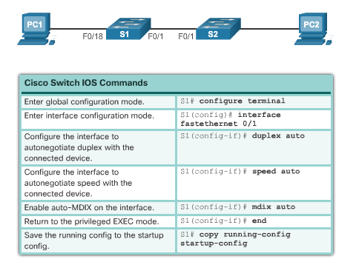
Configure Switch Ports
Auto-MDIX (cont.)
Notes:
5.1 – Basic Switch Configuration
5.1.2 – Configure Switch Ports
5.1.2.3 - Auto-MDIX

Slide 15
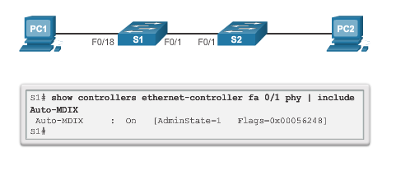
Configure Switch Ports
Auto-MDIX (cont.)
Notes:
5.1 – Basic Switch Configuration
5.1.2 – Configure Switch Ports
5.1.2.3 - Auto-MDIX

Slide 16
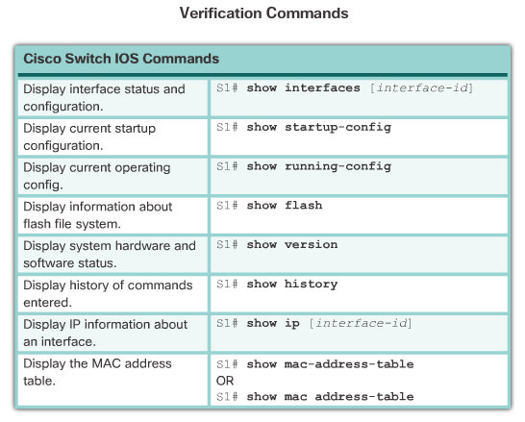
Configure Switch Ports
Verifying Switch Port Configuration
Notes:
5.1 – Basic Switch Configuration
5.1.2 – Configure Switch Ports
5.1.2.4 - Verifying Switch Port Configuration

Slide 17
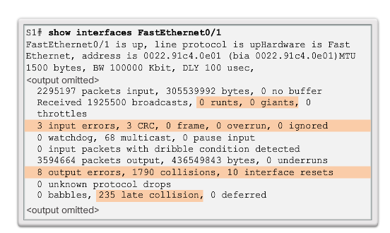
Configure Switch Ports
Network Access Layer Issue
Notes:
5.1 – Basic Switch Configuration
5.1.2 – Configure Switch Ports
5.1.2.5 – Network Access Layer Issue

Slide 18
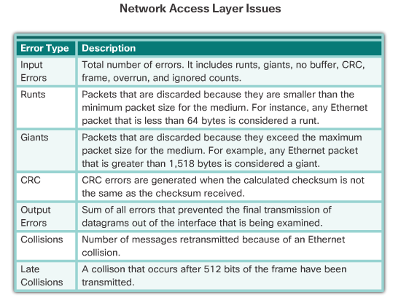
Configure Switch Ports
Network Access Layer Issue (cont.)
Notes:
5.1 – Basic Switch Configuration
5.1.2 – Configure Switch Ports
5.1.2.5 – Network Access Layer Issue

Slide 19
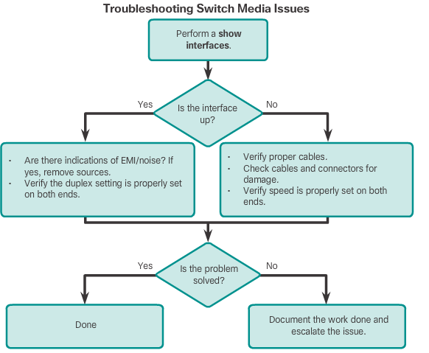
Configure Switch Ports
Troubleshooting Network Access Layer Issues
Notes:
5.1 – Basic Switch Configuration
5.1.2 – Configure Switch Ports
5.1.2.6 - Troubleshooting Network Access Layer Issues

Slide 20
5.2 Switch Security: Management and Implementation
Notes:
Cisco Networking Academy Program
Routing and Switching Essentials v6.0
Chapter 5: Switch Configuration

Slide 21
Secure Remote Access
SSH Operation
Secure Shell (SSH) is a protocol that provides a secure (encrypted), command-line based connection to a remote device.
Because of strong encryption features, SSH should replace Telnet for management connections.
SSH uses TCP port 22, by default.
Telnet uses TCP port 23.
A version of the IOS software, including cryptographic (encrypted) features and capabilities, is required to enable SSH on Catalyst 2960 switches.
Notes:
5.2 – Switch Security: Management and Implementation
5.2.1 – Secure Remote Access
5.2.1.1 - SSH Operation

Slide 22
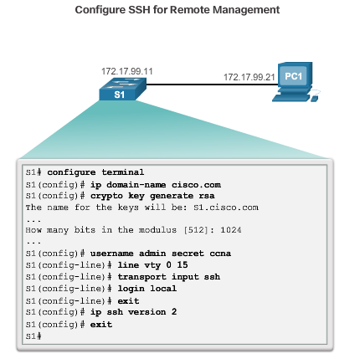
Secure Remote Access
Configuring SSH
Verify SHH Support – show ip ssh
Configure the IP domain.
Generate RSA key pairs.
Configure user authentication.
Configure the vty lines.
Enable SSH version 2.
Notes:
5.2 – Switch Security: Management and Implementation
5.2.1 – Secure Remote Access
5.2.1.2 - Configuring SSH

Slide 23
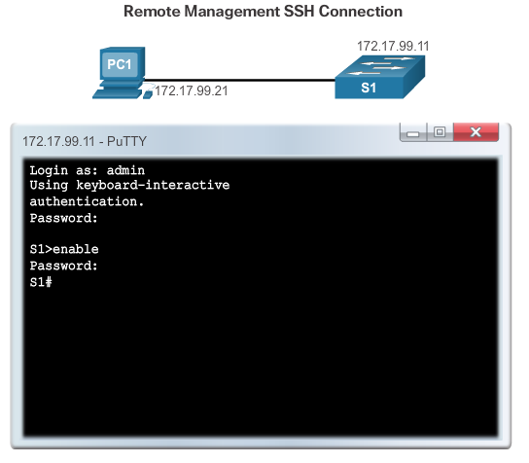
Secure Remote Access
Verifying SSH
Notes:
5.2 – Switch Security: Management and Implementation
5.2.1 – Secure Remote Access
5.2.1.3 - Verifying SSH

Slide 24
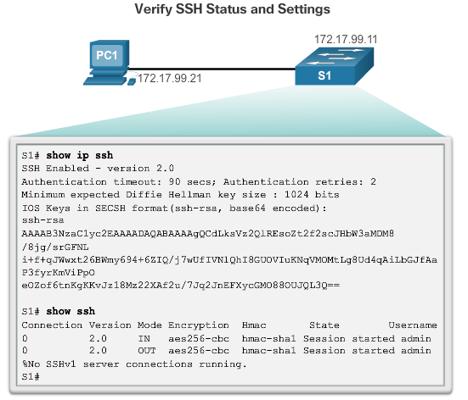
Secure Remote Access
Verifying SSH (cont.)
Notes:
5.2 – Switch Security: Management and Implementation
5.2.1 – Secure Remote Access
5.2.1.3 - Verifying SSH

Slide 25
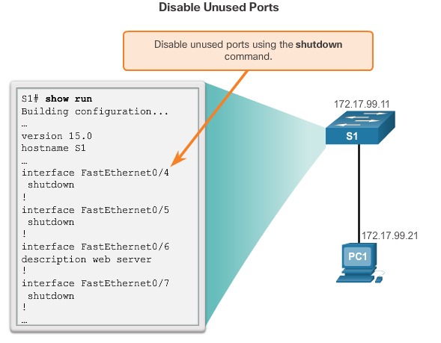
Switch Port Security
Secure Unused Ports
Notes:
5.2 – Switch Security: Management and Implementation
5.2.1 – Switch Port Security
5.2.2.1 - Secure Unused Ports

Slide 26
Switch Port Security
Port Security: Operation
The MAC addresses of legitimate devices are allowed access, while other MAC addresses are denied.
Any additional attempts to connect by unknown MAC addresses generate a security violation.
Secure MAC addresses can be configured in a number of ways:
    Static secure MAC addresses – manually configured and added to running configuration - switchport port-security mac-address mac-address
    Dynamic secure MAC addresses – removed when switch restarts
    Sticky secure MAC addresses – added to running configuration and learned dynamically - switchport port-security mac-address sticky interface configuration mode command
Notes:
5.2 – Switch Security: Management and Implementation
5.2.2 – Switch Port Security
5.2.2.2 - Port Security: Operation

Slide 27
Switch Port Security
Port Security: Violation Modes
IOS considers a security violation when:
    The maximum number of secure MAC addresses for that interface have been added to the CAM, and a station whose MAC address is not in the address table attempts to access the interface.
There are three possible actions to take when a violation is detected:
    Protect – no notification received
    Restrict – notification received of security violation
    Shutdown
    switchport port-security violation {protect | restrict |shutdown} interface configuration mode command
Notes:
5.2 – Switch Security: Management and Implementation
5.2.2 – Switch Port Security
5.2.2.3 - Port Security: Violation Modes

Slide 28
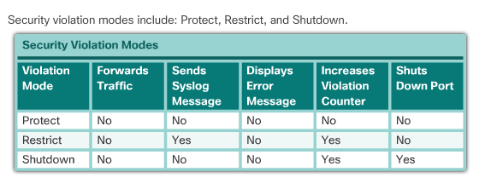
Switch Port Security
Port Security: Violation Modes (cont.)
Notes:
5.2 – Switch Security: Management and Implementation
5.2.2 – Switch Port Security
5.2.2.3 - Port Security: Violation Modes

Slide 29
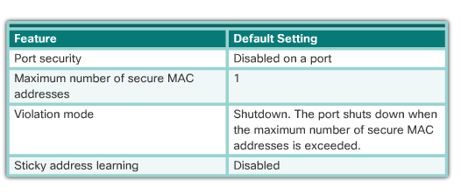
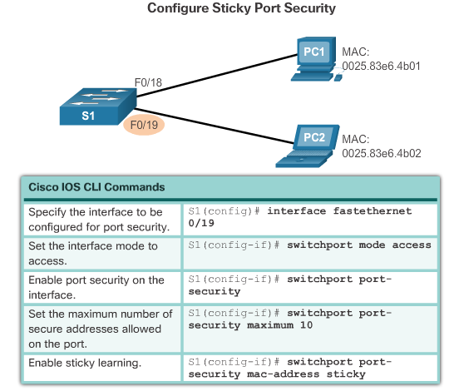
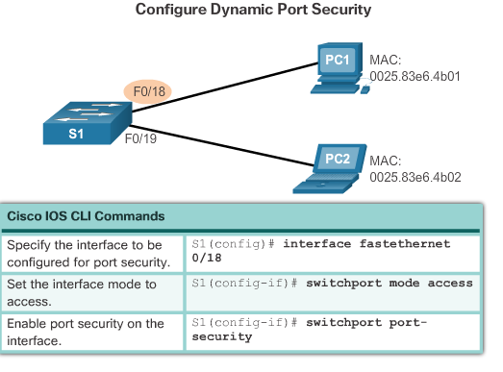
Switch Port Security
Port Security: Configuring
Notes:
5.2 – Switch Security: Management and Implementation
5.2.2 – Switch Port Security
5.2.2.4 - Port Security: Configuring

Slide 30
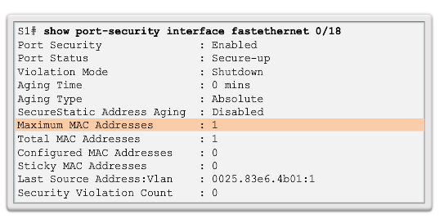
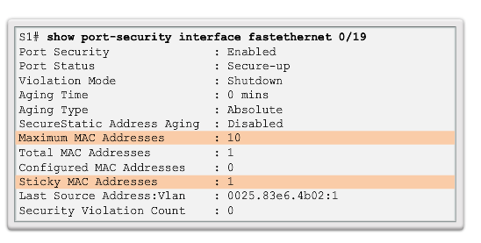
Switch Port Security
Port Security: Verifying
Notes:
5.2 – Switch Security: Management and Implementation
5.2.2 – Switch Port Security
5.2.2.5 - Port Security: Verifying

Slide 31
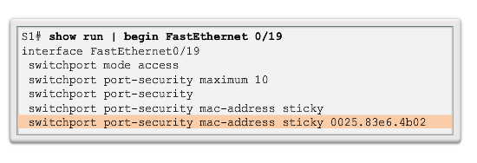
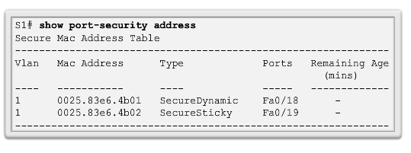
Switch Port Security
Port Security: Verifying (cont.)
Notes:
5.2 – Switch Security: Management and Implementation
5.2.2 – Switch Port Security
5.2.2.5 - Port Security: Verifying

Slide 32
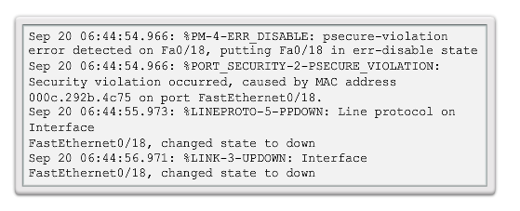
Switch Port Security
Ports in Error Disabled State
A port security violation can put a switch in error disabled state.
A port in error disabled is effectively shutdown.
The switch communicates these events through console messages.
Notes:
5.2 – Switch Security: Management and Implementation
5.2.2 – Switch Port Security
5.2.2.6 - Ports in Error Disabled State

Slide 33
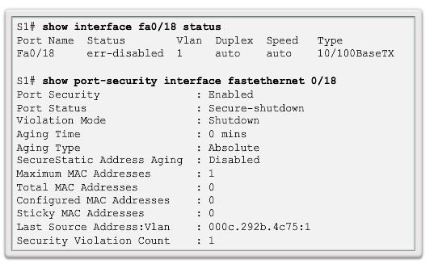

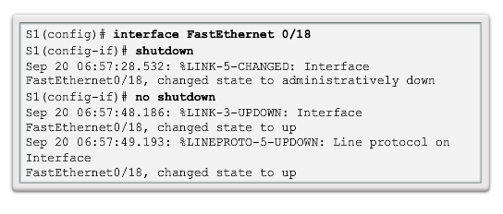
Switch Port Security
Ports in Error Disabled State (cont.)
The show interface command also reveals a switch port on error disabled state.
A shutdown or no shutdown interface configuration mode command must be issued to re-enable the port.
Notes:
5.2 – Switch Security: Management and Implementation
5.2.2 – Switch Port Security
5.2.2.6 - Ports in Error Disabled State

Slide 34
Section 5.1
Terms and Commands
Power on Self-test (POST)
Boot loader
BOOT environment variable
boot system
show boot
Mode button
System LED
boot loader switch:
dir flash:
System LED
Redundant Power System (RPS) LED
Port Status LED
Port Duplex LED
Port Speed LED
Power Over Ethernet (POE) LED
Switch virtual interface (SVI)
VLAN
Full-duplex
Half-duplex
Auto-mdix
interface vlan 99
ip default-gateway
show ip interface brief
duplex auto
speed auto
mdix auto
show interfaces
Input errors
Runts
Giants
CRC Error
Output errors
Collisions
Late Collisions
Notes:
Terms and Commands

Slide 35
Section 5.2
Terms and Commands
Secure Shell (SSH)
show ip ssh version 2
crypto key generate rsa
crypto key zeroize rsa
Username username secret password
transport input ssh
login local
show ip ssh
Static Secure MAC Address
Dynamic Secure MAC Address
Sticky Secure MAC Address
show port-security
show port-security mac-address
show port-security mac-address sticky
show port-security interface
Protect
Restrict
Shutdown
switchport port-security violation{protect | restrict | shutdown}
Switchport port-security maximum #
show port-security interface interface-id
show port-security address
Secure-shutdown
Notes:
Terms and Commands

