Slide 1
Chapter 6: VLANs
Routing and Switching Essentials v6.0
Notes:
Cisco Networking Academy Program
Routing and Switching Essentials v6.0
Chapter 6: VLANs

Slide 2
Chapter 6 - Sections & Objectives
6.1 VLAN Segmentation
Explain the purpose of VLANs in a switched network.
Explain how a switch forwards frames based on VLAN configuration in a multi-switch environment.
6.2 VLAN Implementations
Configure a switch port to be assigned to a VLAN based on requirements.
Configure a trunk port on a LAN switch.
Troubleshoot VLAN and trunk configurations in a switched network.
6.3 Inter-VLAN Routing Using Routers
Describe the two options for configuring Inter-VLAN routing.
Configure Legacy Inter-VLAN Routing.
Configure Router-on-a-Stick Inter-VLAN Routing
Notes:
2

Slide 3
6.1 VLAN Segmentation
Notes:
Cisco Networking Academy Program
Routing and Switching Essentials v6.0
Chapter 6: VLANs

Slide 4
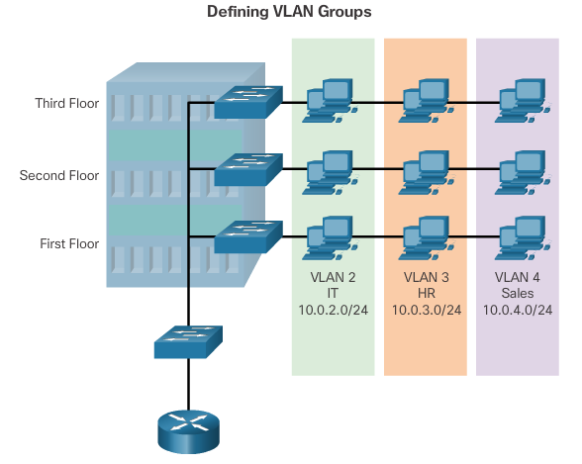
Overview of VLANs VLAN Definitions
Notes:
6.1 – VLAN Segmentation
6.1.1 – Overview of VLANs
6.1.1.1 – VLAN Definitions

Slide 5
Overview of VLANs VLAN Definitions (cont.)
VLANs allow an administrator to segment networks based on factors such as function, project team, or application, without regard for the physical location of the user or device.
VLANs enable the implementation of access and security policies according to specific groupings of users.
A VLAN is a logical partition of a Layer 2 network.
Each VLAN is a broadcast domain, usually with its own IP network.
VLANs are mutually isolated, and packets can only pass between them via a router.
The partitioning of the Layer 2 network takes place inside a Layer 2 device, usually via a switch.
The hosts grouped within a VLAN are unaware of the VLAN’s existence.
Notes:
6.1 – VLAN Segmentation
6.1.1 – Overview of VLANs
6.1.1.1 – VLAN Definitions (cont.)

Slide 6
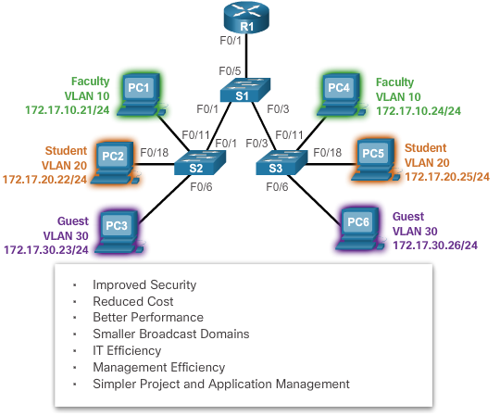
Overview of VLANs Benefits of VLANs
Notes:
6.1 – VLAN Segmentation
6.1.1 – Overview of VLANs
6.1.1.2 – Benefits of VLANs

Slide 7
Overview of VLANs Types of VLANs
Data VLAN – user generated traffic
Default VLAN – all switch ports become part of this VLAN until switch is configured, show vlan brief (usually VLAN 1)
Native VLAN – used for untagged traffic
Management VLAN – used to access management capabilities
Notes:
6.1 – VLAN Segmentation
6.1.1 – Overview of VLANs
6.1.1.3 – Types of VLANs

Slide 8
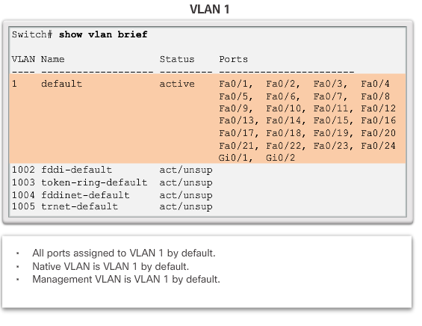
Overview of VLANs Types of VLANs (cont.)
Notes:
6.1 – VLAN Segmentation
6.1.1 – Overview of VLANs
6.1.1.3 – Types of VLANs (cont.)

Slide 9
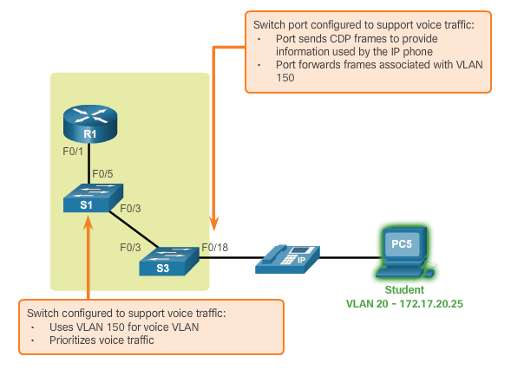
Overview of VLANs Voice VLANs
Notes:
6.1 – VLAN Segmentation
6.1.1 – Overview of VLANs
6.1.1.4 – Voice VLANs

Slide 10
Overview of VLANs Voice VLANs (cont.)
VoIP traffic is time-sensitive and requires:
Assured bandwidth to ensure voice quality.
Transmission priority over other types of network traffic.
Ability to be routed around congested areas on the network.
Delay of less than 150 ms across the network.
The voice VLAN feature enables access ports to carry IP voice traffic from an IP phone.
Notes:
6.1 – VLAN Segmentation
6.1.1 – Overview of VLANs
6.1.1.4 – Voice VLANs (cont.)

Slide 11
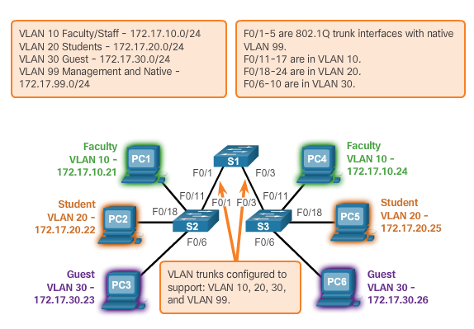
VLANs in a Multi-Switched Environment VLAN Trunks
The links between switches S1 and S2, and S1 and S3 are configured to transmit traffic coming from VLANs 10, 20, 30, and 99 across the network. This network could not function without VLAN trunks.
Notes:
6.1 – VLAN Segmentation
6.1.2 – VLANs in a Multi-Switched Environment
6.1.2.1 – VLAN Trunks

Slide 12
VLANs in a Multi-Switched Environment VLAN Trunks (cont.)
A VLAN trunk is a point-to-point link that carries more than one VLAN.
A VLAN trunk is usually established between switches so same-VLAN devices can communicate, even if physically connected to different switches.
A VLAN trunk is not associated to any VLANs; neither is the trunk ports used to establish the trunk link.
Cisco IOS supports IEEE802.1q, a popular VLAN trunk protocol.
Notes:
6.1 – VLAN Segmentation
6.1.2 – VLANs in a Multi-Switched Environment
6.1.2.1 – VLAN Trunks (cont.)

Slide 13
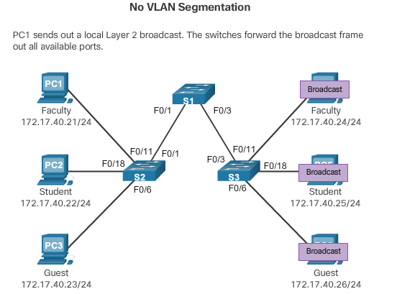
VLANs in a Multi-Switched Environment Controlling Broadcast Domains with VLANs
Notes:
6.1 – VLAN Segmentation
6.1.2 – VLANs in a Multi-Switched Environment
6.1.2.2 - Controlling Broadcast Domains with VLANs

Slide 14
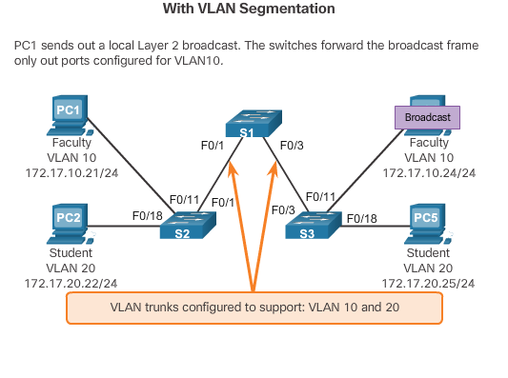
VLANs in a Multi-Switched Environment Controlling Broadcast Domains with VLANs
Notes:
6.1 – VLAN Segmentation
6.1.2 – VLANs in a Multi-Switched Environment
6.1.2.2 - Controlling Broadcast Domains with VLANs (cont.)

Slide 15
VLANs in a Multi-Switched Environment Controlling Broadcast Domains with VLANs
VLANs can be used to limit the reach of broadcast frames.
A VLAN is a broadcast domain of its own.
A broadcast frame sent by a device in a specific VLAN is forwarded within that VLAN only.
VLANs help control the reach of broadcast frames and their impact in the network.
Unicast and multicast frames are forwarded within the originating VLAN.
Notes:
6.1 – VLAN Segmentation
6.1.2 – VLANs in a Multi-Switched Environment
6.1.2.2 - Controlling Broadcast Domains with VLANs (cont.)

Slide 16
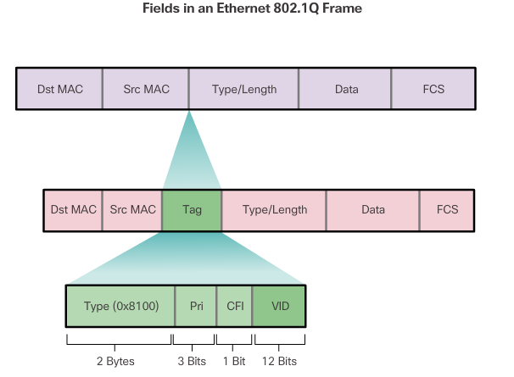
VLANs in a Multi-Switched Environment Tagging Ethernet Frames for VLAN Identification (cont.)
Notes:
6.1 – VLAN Segmentation
6.1.2 – VLANs in a Multi-Switched Environment
6.1.2.3 - Tagging Ethernet Frames for VLAN Identification (cont.)

Slide 17
VLANs in a Multi-Switched Environment Native VLANs and 802.1Q Tagging
Control traffic sent on the native VLAN should not be tagged.
Frames received untagged, remain untagged and are placed in the native VLAN when forwarded.
If there are no ports associated to the native VLAN and no other trunk links, an untagged frame is dropped.
When configuring a switch port on a Cisco switch, configure devices so that they do not send tagged frames on the native VLAN.
In Cisco switches, the native VLAN is VLAN 1, by default.
Notes:
6.1 – VLAN Segmentation
6.1.2 – VLANs in a Multi-Switched Environment
6.1.2.4 - Native VLANs and 802.1Q Tagging

Slide 18
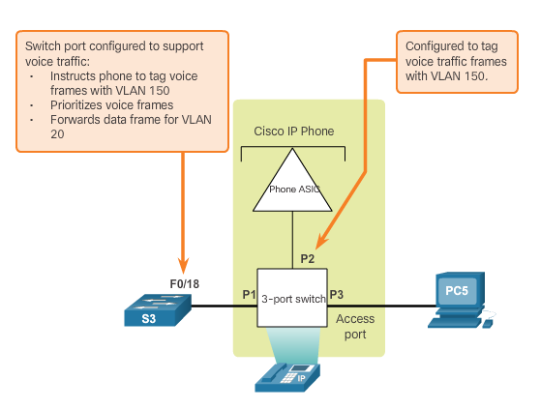
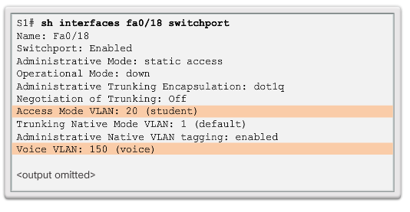
VLANs in a Multi-Switched Environment Voice VLAN Tagging
Notes:
6.1 – VLAN Segmentation
6.1.2 – VLANs in a Multi-Switched Environment
6.1.2.5 - Voice VLAN Tagging

Slide 19
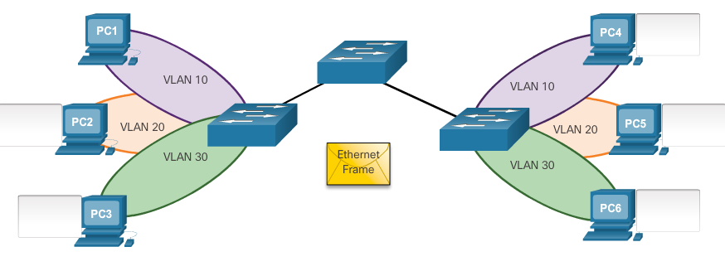
VLANs in a Multi-Switched Environment Activity – Predict Switch Behavior
Scenario 1: PC 1 sends a broadcast.
Scenario 2: PC 2 sends a broadcast.
Scenario 3: PC 3 sends a broadcast.
Notes:
6.1 – VLAN Segmentation
6.1.2 – VLANs in a Multi-Switched Environment
6.1.2.6 - Activity – Predict Switch Behavior

Slide 20
6.2 VLAN Implementations
Notes:
Cisco Networking Academy Program
Routing and Switching Essentials v6.0
Chapter 6: VLANs

Slide 21
VLAN Assignment VLAN Ranges on Catalyst Switches
Cisco Catalyst 2960 and 3560 Series switches support over 4,000 VLANs.
VLANs are split into two categories:
Normal range VLANs
VLAN numbers from 1 to 1,005
Configurations stored in the vlan.dat (in the flash memory)
IDs 1002 through 1005 are reserved for Token Ring and Fiber Distributed Data Interface (FDDI) VLANs, automatically created and cannot be removed
Extended Range VLANs
VLAN numbers from 1,006 to 4,096
Configurations stored in the running configuration (NVRAM)
VLAN Trunking Protocol (VTP) does not learn extended VLANs
Notes:
6.2 – VLAN Implementations
6.2.1 – VLAN Assignment
6.2.1.1 - VLAN Ranges on Catalyst Switches

Slide 22
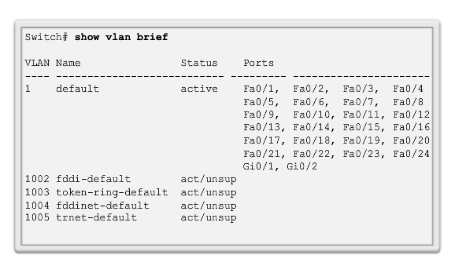
VLAN Assignment VLAN Ranges on Catalyst Switches (cont.)
Normal Range VLANs
Notes:
6.2 – VLAN Implementations
6.2.1 – VLAN Assignment
6.2.1.1 - VLAN Ranges on Catalyst Switches

Slide 23
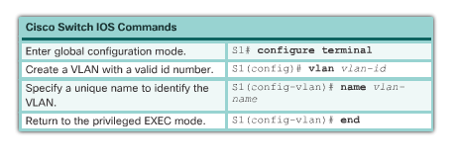
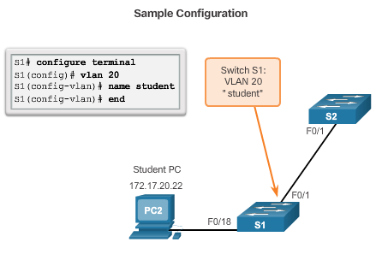
VLAN Assignment Creating a VLAN
Notes:
6.2 – VLAN Implementations
6.2.1 – VLAN Assignment
6.2.1.2 – Creating a VLAN

Slide 24
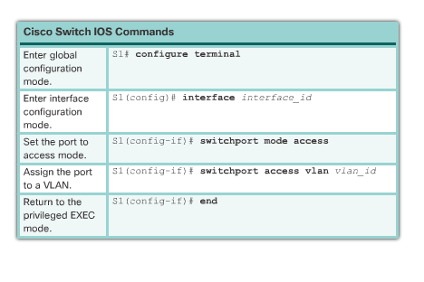
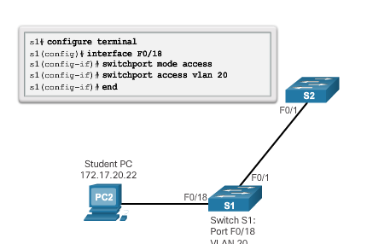
VLAN Assignment Assigning Ports to VLANs
Notes:
6.2 – VLAN Implementations
6.2.1 – VLAN Assignment
6.2.1.3 – Assigning Ports to VLANs

Slide 25
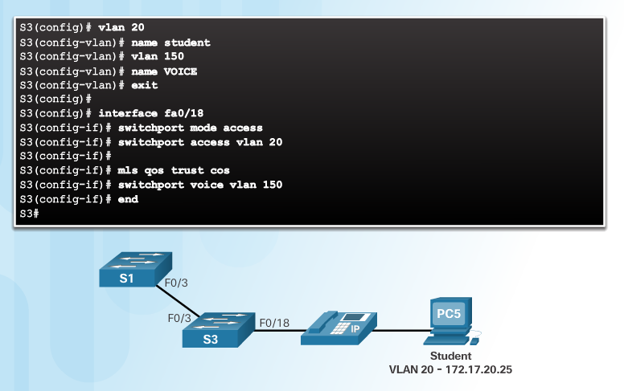
VLAN Assignment Assigning Ports to VLANs
Notes:
6.2 – VLAN Implementations
6.2.1 – VLAN Assignment
6.2.1.3 – Assigning Ports to VLANs

Slide 26
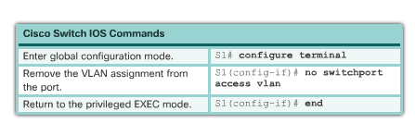
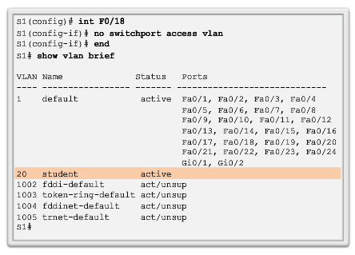
VLAN Assignment Changing VLAN Port Membership
Remove VLAN Assignment
Interface F0/18 was previously assigned to VLAN 20 which is still active, F0/18 reset to VLAN1
Notes:
6.2 – VLAN Implementations
6.2.1 – VLAN Assignment
6.2.1.4 - Changing VLAN Port Membership

Slide 27
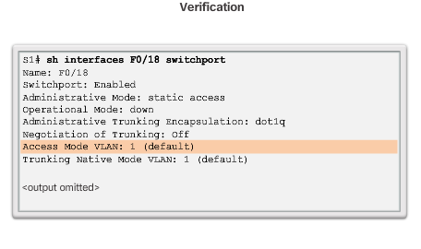
VLAN Assignment Changing VLAN Port Membership (cont.)
Notes:
6.2 – VLAN Implementations
6.2.1 – VLAN Assignment
6.2.1.4 - Changing VLAN Port Membership (cont.)

Slide 28
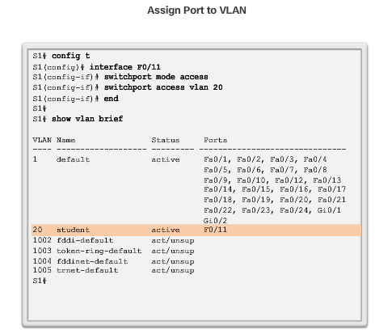
VLAN Assignment Changing VLAN Port Membership (cont.)
Notes:
6.2 – VLAN Implementations
6.2.1 – VLAN Assignment
6.2.1.4 - Changing VLAN Port Membership (cont.)

Slide 29
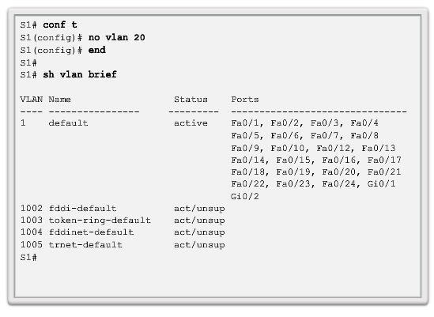
VLAN Assignment Deleting VLANs
The entire vlan.dat file can be deleted using the delete flash:vlan.dat privileged EXEC mode command
Abbreviated command version (delete vlan.dat) can be used if the vlan.dat file has not been moved from its default location
Notes:
6.2 – VLAN Implementations
6.2.1 – VLAN Assignment
6.2.1.5 – Deleting VLANs

Slide 30
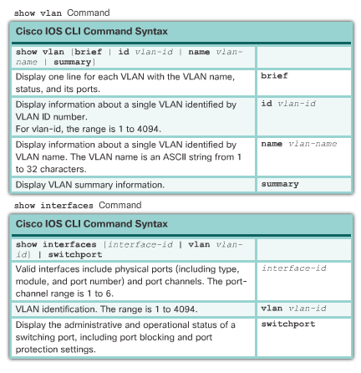
VLAN Assignment Verifying VLAN Information
Notes:
6.2 – VLAN Implementations
6.2.1 – VLAN Assignment
6.2.1.6 - Verifying VLAN Information

Slide 31
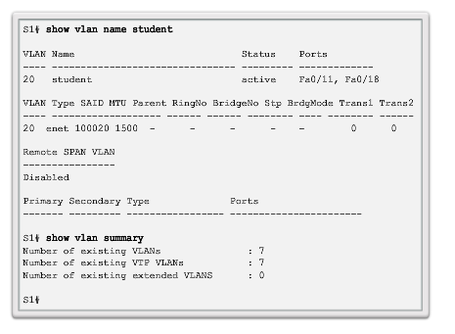
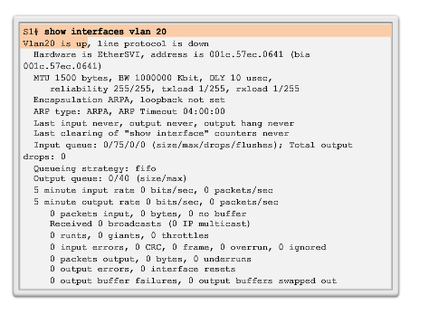
VLAN Assignment Verifying VLAN Information (cont.)
Notes:
6.2 – VLAN Implementations
6.2.1 – VLAN Assignment
6.2.1.6 - Verifying VLAN Information

Slide 32
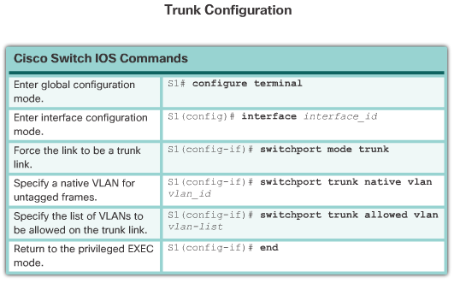
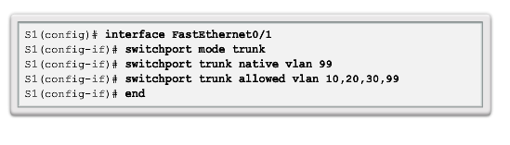
VLAN Trunks Configuring IEEE 802.1q Trunk Links
Notes:
6.2 – VLAN Implementations
6.2.2 – VLAN Trunks
6.2.2.1 - Configuring IEEE 802.1q Trunk Links

Slide 33
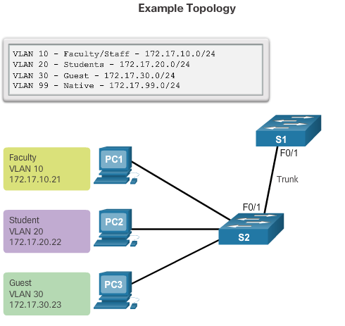
VLAN Assignment Configuring IEEE 802.1q Trunk Links (cont.)
Notes:
6.2 – VLAN Implementations
6.2.2 – VLAN Trunks
6.2.2.1 - Configuring IEEE 802.1q Trunk Links (cont.)

Slide 34
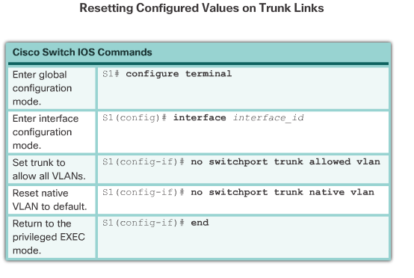
VLAN Trunks Resetting the Trunk to Default State
Notes:
6.2 – VLAN Implementations
6.2.2 – VLAN Trunks
6.2.2.2 - Resetting the Trunk to Default State

Slide 35
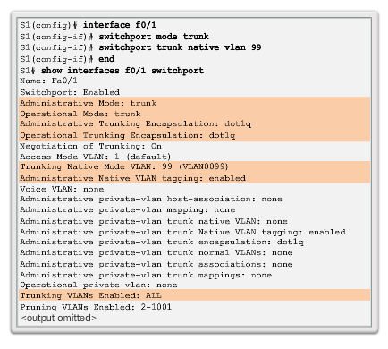
VLAN Trunks Verifying Trunk Configuration
Notes:
6.2 – VLAN Implementations
6.2.2 – VLAN Trunk
6.2.2.3 - Verifying Trunk Configuration

Slide 36
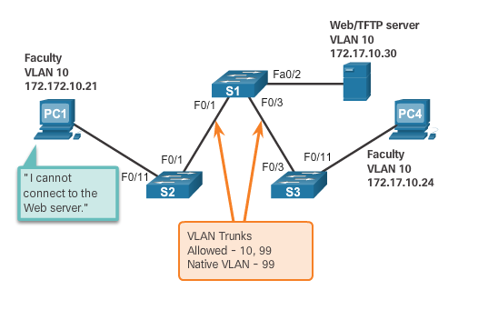
Troubleshoot VLANs and Trunks IP Addressing Issues with VLANs
It is a common practice to associate a VLAN with an IP network.
Because different IP networks only communicate through a router, all devices within a VLAN must be part of the same IP network to communicate.
The figure displays that PC1 cannot communicate to the server because it has a wrong IP address configured.
Notes:
6.2 – VLAN Implementations
6.2.3 – Troubleshoot VLANs and Trunks
6.2.3.1 - IP Addressing Issues with VLANs

Slide 37
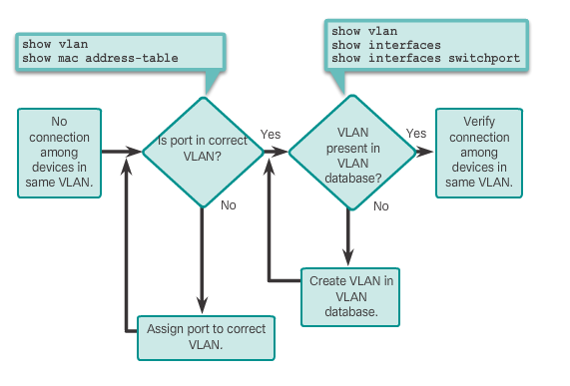
Troubleshoot VLANs and Trunks Missing VLANs
If all the IP address mismatches have been solved, but the device still cannot connect, check if the VLAN exists in the switch.
Notes:
6.2 – VLAN Implementations
6.2.3 – Troubleshoot VLANs and Trunks
6.2.3.2 - Missing VLANs

Slide 38
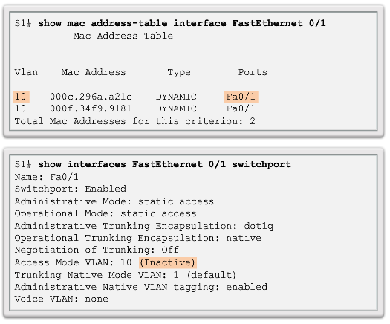
Troubleshoot VLANs and Trunks Missing VLANs (cont.)
If the VLAN to which a port belongs is deleted, the port becomes inactive. All ports belonging to the VLAN that was deleted are unable to communicate with the rest of the network.
Not functional until the missing VLAN is created using the vlan vlan_id global configuration.
Notes:
6.2 – VLAN Implementations
6.2.3 – Troubleshoot VLANs and Trunks
6.2.3.2 - Missing VLANs (cont.)

Slide 39
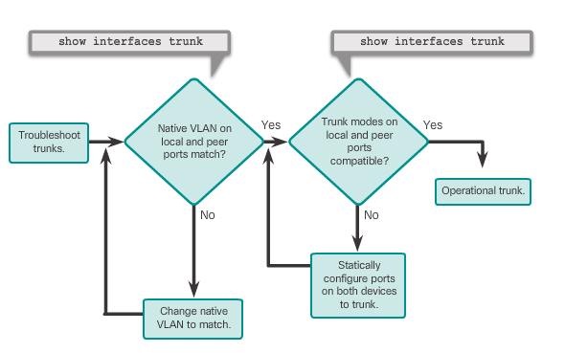
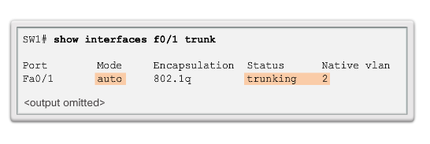
Troubleshoot VLANs and Trunks Introduction to Troubleshooting Trunks
Note: To solve a native VLAN mismatch, configure the native VLAN to be the same VLAN on both sides of the link.
Notes:
6.2 – VLAN Implementations
6.2.3 – Troubleshoot VLANs and Trunks
6.2.3.3 - Introduction to Troubleshooting Trunks

Slide 40
Troubleshoot VLANs and Trunks Common Problems with Trunks
Trunking issues are usually associated with incorrect configurations.
The most common type of trunk configuration errors are:
Native VLAN mismatches
Trunk mode mismatches
Allowed VLANs on trunks
If a trunk problem is detected, the best practice guidelines recommend to troubleshoot in the order shown above.
Notes:
6.2 – VLAN Implementations
6.2.3 – Troubleshoot VLANs and Trunks
6.2.3.4 - Common Problems with Trunks

Slide 41
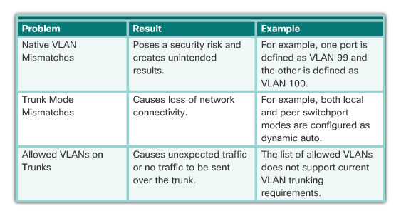
Troubleshoot VLANs and Trunks Common Problems with Trunks (cont.)
Notes:
6.2 – VLAN Implementations
6.2.3 – Troubleshoot VLANs and Trunks
6.2.3.4 - Common Problems with Trunks

Slide 42
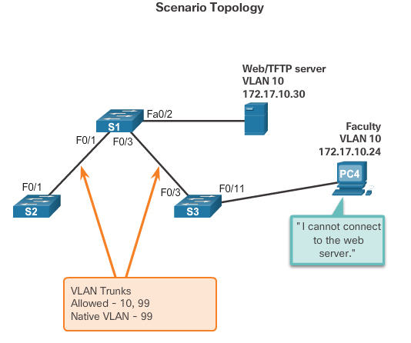
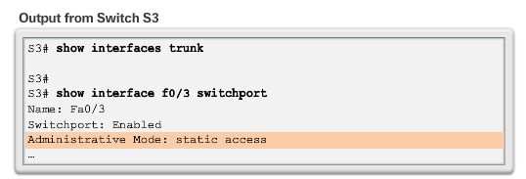
Troubleshoot VLANs and Trunks Incorrect Port Mode
Notes:
6.2 – VLAN Implementations
6.2.3 – Troubleshoot VLANs and Trunks
6.2.3.5 - Incorrect Port Mode

Slide 43
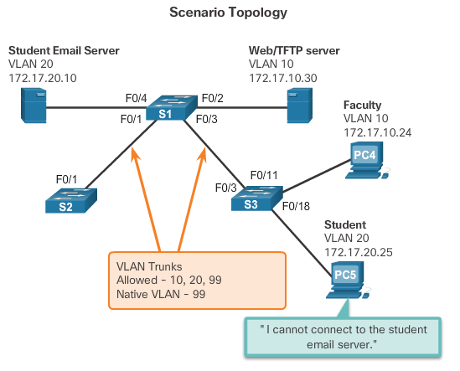
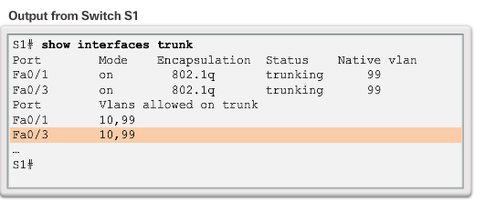
Troubleshoot VLANs and Trunks Incorrect VLAN List
Notes:
6.2 – VLAN Implementations
6.2.3 – Troubleshoot VLANs and Trunks
6.2.3.6 - Incorrect VLAN List

Slide 44
Troubleshoot VLANs and Trunks Incorrect VLAN List (cont.)
VLANs must be allowed in the trunk before their frames can be transmitted across the link.
Use the switchport trunk allowed vlan command to specify which VLANs are allowed in a trunk link.
Use the show interfaces trunk command to ensure the correct VLANs are permitted in a trunk.
Notes:
6.2 – VLAN Implementations
6.2.3 – Troubleshoot VLANs and Trunks
6.2.3.6 - Incorrect VLAN List (cont.)

Slide 45
6.3 Inter-VLAN Routing Using Routers
Notes:
Cisco Networking Academy Program
Routing and Switching Essentials v6.0
Chapter 6: VLANs

Slide 46
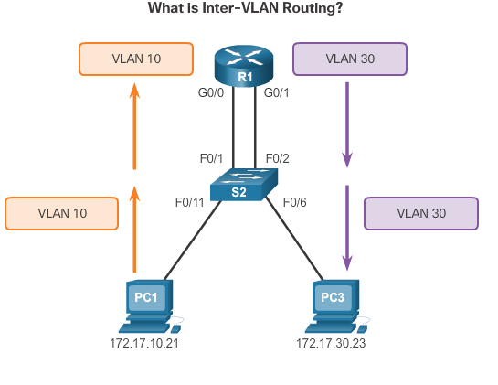
Inter-VLAN Routing Operation What is Inter-VLAN Routing?
Layer 2 switches cannot forward traffic between VLANs without the assistance of a router.
Inter-VLAN routing is a process for forwarding network traffic from one VLAN to another, using a router.
Notes:
6.3 – Inter-VLAN Routing Using Routers
6.3.1 – Inter-VLAN Routing Operation
6.3.1.1 - What is Inter-VLAN Routing?

Slide 47
Inter-VLAN Routing Operation Legacy Inter-VLAN Routing
In the past:
Actual routers were used to route between VLANs.
Each VLAN was connected to a different physical router interface.
Packets would arrive on the router through one interface, be routed and leave through another.
Because the router interfaces were connected to VLANs and had IP addresses from that specific VLAN, routing between VLANs was achieved.
Large networks with large number of VLANs required many router interfaces.
Notes:
6.3 – Inter-VLAN Routing Using Routers
6.3.1 – Inter-VLAN Routing Operation
6.3.1.2 - Legacy Inter-VLAN Routing

Slide 48
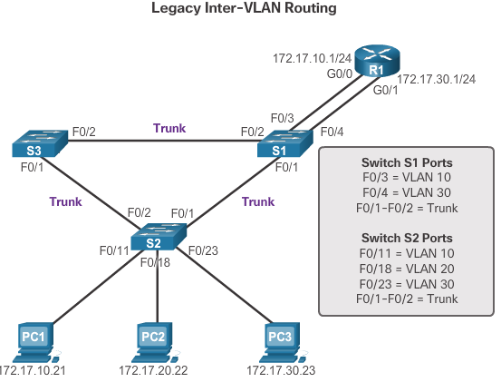
Inter-VLAN Routing Operation Legacy Inter-VLAN Routing (cont.)
In this example, the router was configured with two separate physical interfaces to interact with the different VLANs and perform the routing.
Notes:
6.3 – Inter-VLAN Routing Using Routers
6.3.1 – Inter-VLAN Routing Operation
6.3.1.2 - Legacy Inter-VLAN Routing (cont.)

Slide 49
Inter-VLAN Routing Operation Router-on-a-Stick Inter-VLAN Routing
The router-on-a-stick approach uses only one of the router’s physical interface.
One of the router’s physical interfaces is configured as a 802.1Q trunk port so it can understand VLAN tags.
Logical subinterfaces are created; one subinterface per VLAN.
Each subinterface is configured with an IP address from the VLAN it represents.
VLAN members (hosts) are configured to use the subinterface address as a default gateway.
Notes:
6.3 – Inter-VLAN Routing Using Routers
6.3.1 – Inter-VLAN Routing Operation
6.3.1.3 - Router-on-a-Stick Inter-VLAN Routing

Slide 50
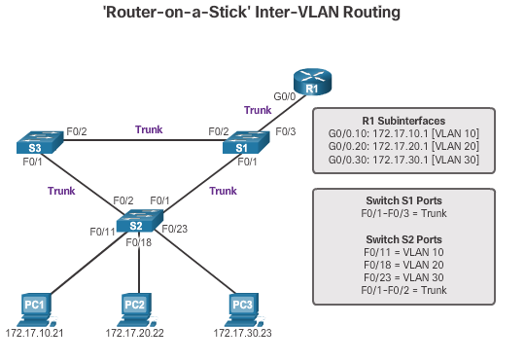
Inter-VLAN Routing Operation Router-on-a-Stick Inter-VLAN Routing (cont.)
Router interface configured to operate as a trunk link and is connected to a trunked switch port. The router performs inter-VLAN routing by accepting VLAN-tagged traffic on the trunk interface coming from the adjacent switch, and then, internally routing between the VLANs using subinterfaces. The router then forwards the routed traffic, VLAN-tagged for the destination VLAN, out the same physical interface as it used to receive the traffic.
Notes:
6.3 – Inter-VLAN Routing Using Routers
6.3.1 – Inter-VLAN Routing Operation
6.3.1.3 - Router-on-a-Stick Inter-VLAN Routing (cont.)

Slide 51
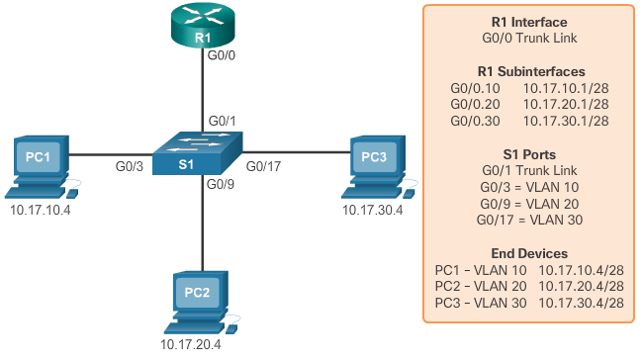
Inter-VLAN Routing Operation Identify the Types of Inter-VLAN Routing Activity
Legacy or Router-on-a-Stick?
Notes:
6.3 – Inter-VLAN Routing Using Router
6.3.1 – Inter-VLAN Routing Operation
6.3.1.4 - Identify the Types of Inter-VLAN Routing Activity

Slide 52
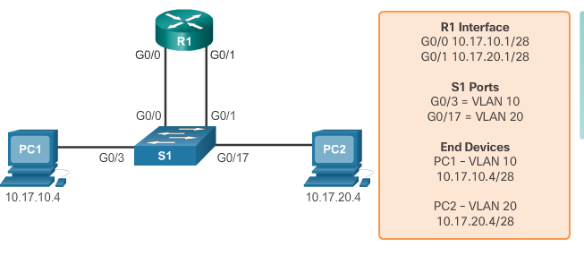
Inter-VLAN Routing Operation Identify the Types of Inter-VLAN Routing Activity (cont.)
Legacy or Router-on-a-Stick?
Notes:
6.3 – Inter-VLAN Routing Using Router
6.3.1 – Inter-VLAN Routing Operation
6.3.1.4 - Identify the Types of Inter-VLAN Routing Activity (cont.)

Slide 53
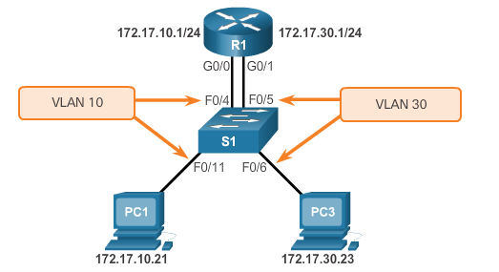
Configure Legacy Inter-VLAN Routing Configure Legacy Inter-VLAN Routing: Preparation
Legacy inter-VLAN routing requires routers to have multiple physical interfaces.
Each one of the router’s physical interfaces is connected to a unique VLAN.
Each interface is also configured with an IP address for the subnet associated with the particular VLAN.
Network devices use the router as a gateway to access the devices connected to the other VLANs.
Notes:
6.3 – Inter-VLAN Routing Using Routers
6.3.2 – Configure Legacy Inter-VLAN Routing
6.3.2.1 - Configure Legacy Inter-VLAN Routing: Preparation

Slide 54
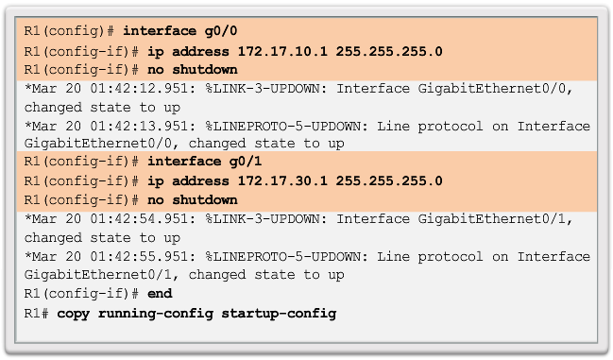
Configure Legacy Inter-VLAN Routing Configure Legacy Inter-VLAN Routing: Switch Configuration
Notes:
6.3 – Inter-VLAN Routing Using Routers
6.3.2 – Configure Legacy Inter-VLAN Routing
6.3.2.2 - Configure Legacy Inter-VLAN Routing: Switch Configuration

Slide 55
Configure Legacy Inter-VLAN Routing Configure Legacy Inter-VLAN Routing: Router Interface Configuration
Notes:
6.3 – Inter-VLAN Routing Using Routers
6.3.2 – Configure Legacy Inter-VLAN Routing
6.3.2.3 - Configure Legacy Inter-VLAN Routing: Router Interface Configuration

Slide 56
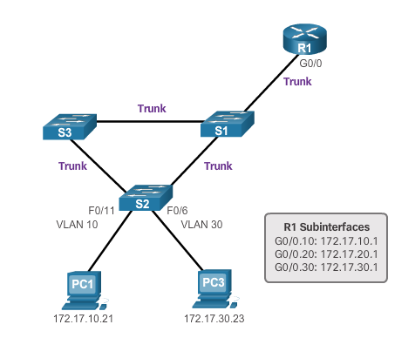
Configure Router-on-a-Stick Inter-VLAN Routing Configure Router-on-a Stick: Preparation
An alternative to legacy inter-VLAN routing is to use VLAN trunking and subinterfaces.
VLAN trunking allows a single physical router interface to route traffic for multiple VLANs.
The physical interface of the router must be connected to a trunk link on the adjacent switch.
On the router, subinterfaces are created for each unique VLAN.
Each subinterface is assigned an IP address specific to its subnet or VLAN and is also configured to tag frames for that VLAN.
Notes:
6.3 – Inter-VLAN Routing Using Routers
6.3.3 – Configure Router-on-a-Stick Inter-VLAN Routing
6.3.3.1 - Configure Router-on-a Stick: Preparation

Slide 57
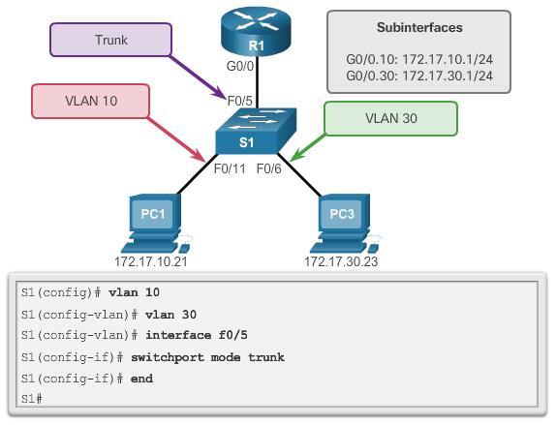
Configure Router-on-a-Stick Inter-VLAN Routing Configure Router-on-a Stick: Switch Configuration
Notes:
6.3 – Inter-VLAN Routing Using Routers
6.3.3 – Configure Router-on-a-Stick Inter-VLAN Routing
6.3.3.2 - Configure Router-on-a Stick: Switch Configuration

Slide 58
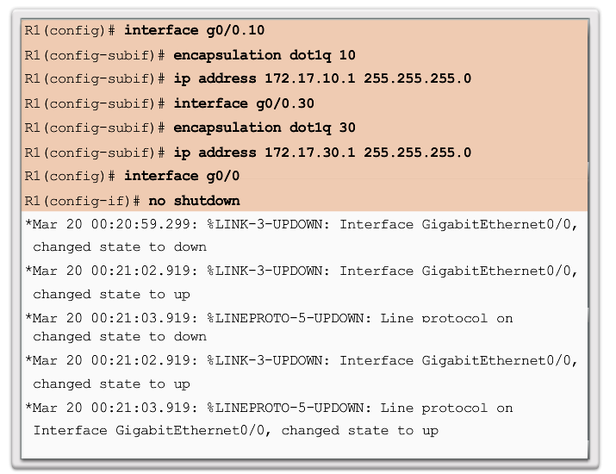
Configure Router-on-a-Stick Inter-VLAN Routing Configure Router-on-a Stick: Router Subinterface Configuration
Notes:
6.3 – Inter-VLAN Routing Using Routers
6.3.3 – Configure Router-on-a-Stick Inter-VLAN Routing
6.3.3.3 - Configure Router-on-a Stick: Router Subinterface Configuration

Slide 59

Configure Router-on-a-Stick Inter-VLAN Routing Configure Router-on-a Stick: Verifying Subinterfaces
Notes:
6.3 – Inter-VLAN Routing Using Routers
6.3.3 – Configure Router-on-a-Stick Inter-VLAN Routing
6.3.3.4 - Configure Router-on-a Stick: Verifying Subinterfaces

Slide 60

Configure Router-on-a-Stick Inter-VLAN Routing Configure Router-on-a Stick: Verifying Subinterfaces (cont.)
Notes:
6.3 – Inter-VLAN Routing Using Routers
6.3.2 – Configure Router-on-a-Stick Inter-VLAN Routing
6.3.3.4 - Configure Router-on-a Stick: Verifying Subinterfaces (cont.)

Slide 61
Configure Router-on-a-Stick Inter-VLAN Routing Configure Router-on-a Stick: Verifying Routing
Access to devices on remote VLANs can be tested using the ping command.
The ping command sends an ICMP echo request to the destination address.
When a host receives an ICMP echo request, it responds with an ICMP echo reply.
Tracert is a useful utility for confirming the routed path taken between two devices.
Notes:
6.3 – Inter-VLAN Routing Using Routers
6.3.3 – Configure Router-on-a-Stick Inter-VLAN Routing
6.3.3.5 - Configure Router-on-a Stick: Verifying Routing

Slide 62
Section 6.1 Terms and Commands
VLAN
Logical broadcast domain
Data VLAN
Default VLAN
Native VLAN
Management VLAN
show vlan brief
Voice VLAN
VLAN Trunk
VLAN Segmentation
IEEE 802.1Q
VLAN Tagging
Canonical Format Identifier (CFI)
User Priority
VLAN ID
Type
show interfaces int switchport
Notes:
Terms and Commands

Slide 63
Section 6.2 Terms and Commands
Normal Range VLANs
Extended Range VLANs
vlan vlan-id
name vlan-name
switchport mode access
switchport access vlan vlan-id
interface range
no switchport access vlan vlan-id
no vlan vlan-id
delete flash:vlan.dat
delete vlan.dat
show vlan
show interfaces
show vlan summary
show interfaces vlan vlan_id
switchport mode trunk
switchport trunk allowed vlan vlan_list
switchport trunk native vlan vlan_id
no switchport trunk allowed vlan
no switchport trunk native vlan
show interfaces switchport
no switchport access vlan vlan_id
show interfaces trunk
show interfaces int_id trunk
Notes:
New Terms and Commands

