Slide 1
Chapter 8: DHCP
Routing and Switching Essentials v6.0
Notes:
Cisco Networking Academy Program
Routing and Switching Essentials v6.0
Chapter 8: DHCP

Slide 2
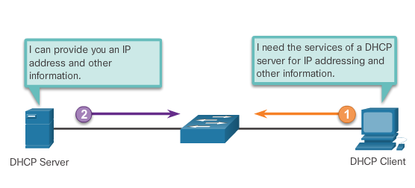
DHCPv4 Operation Introducing DHCPv4
DHCPv4:
assigns IPv4 addresses and other network configuration information dynamically
useful and timesaving tool for network administrators
dynamically assigns, or leases, an IPv4 address from a pool of addresses
A Cisco router can be configured to provide DHCPv4 services.
Administrators configure DHCPv4 servers so that leases expire. Then the client must ask for another address, although the client is typically reassigned the same address.
Notes:
8.1 – Dynamic Host Configuration Protocol v4
8.1.1 – DHCPv4 Operation
8.1.1.1 – Introduction DHCPv4

Slide 3
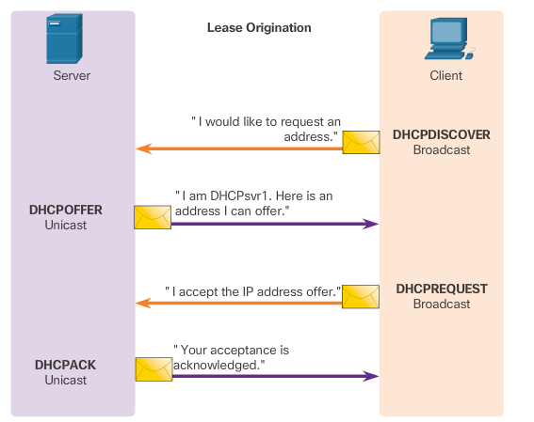
DHCPv4 Operation DHCPv4 Operation
Notes:
8.1 – Dynamic Host Configuration Protocol v4
8.1.1 – DHCPv4 Operation
8.1.1.2 – DHCPv4 Operation

Slide 4
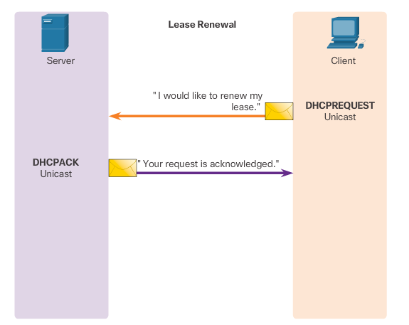
DHCPv4 Operation DHCPv4 Operation (cont.)
Notes:
8.1 – Dynamic Host Configuration Protocol v4
8.1.1 – DHCPv4 Operation
8.1.1.2 – DHCPv4 Operation

Slide 5
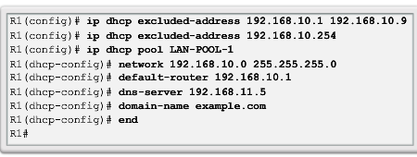
Configure DHCPv4 Server Configure a Basic DHCPv4 Server
A Cisco router running the Cisco IOS software can be configured to act as a DHCPv4 server. To set up DHCP:
Exclude addresses from the pool.
Set up the DHCP pool name.
Define the range of addresses and subnet mask. Use the default-router command for the default gateway. Optional parameters that can be included in the pool – dns server, domain-name.
To disable DHCP, use the no service dhcp command.
Notes:
8.1 – Dynamic Host Configuration Protocol v4
8.1.2 – Configure DHCPv4 Server
8.1.2.1 - Configure a Basic DHCPv4 Server

Slide 6
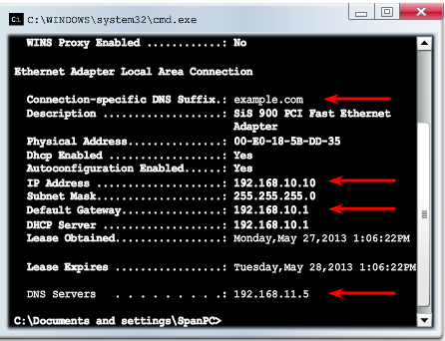
Configure DHCPv4 Server Verifying DHCPv4
Commands to verify DHCP:
show running-config | section dhcp
show ip dhcp binding
show ip dhcp server statistics
On the PC, issue the ipconfig /all command.
Notes:
8.1 – Dynamic Host Configuration Protocol v4
8.1.2 – Configure DHCPv4 Server
8.1.2.2 - Verifying DHCPv4

Slide 7
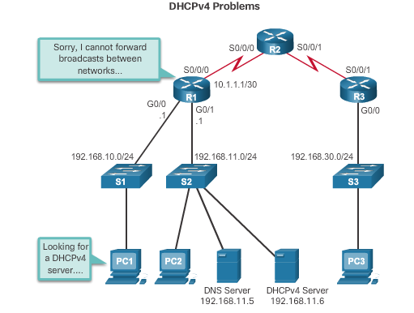
Configure DHCPv4 Server DHCPv4 Relay
Notes:
8.1 – Dynamic Host Configuration Protocol v4
8.1.2 – Configure DHCPv4 Server
8.1.2.3 - DHCPv4 Relay

Slide 8
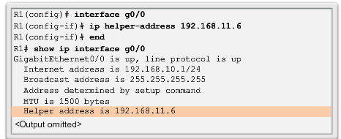
Configure DHCPv4 Server DHCPv4 Relay (cont.)
Using an IP helper address enables a router to forward DHCPv4 broadcasts to the DHCPv4 server. Acting as a relay.
Notes:
8.1 – Dynamic Host Configuration Protocol v4
8.1.2 – Configure DHCPv4 Server
8.1.2.3 - DHCPv4 Relay (cont.)

Slide 9
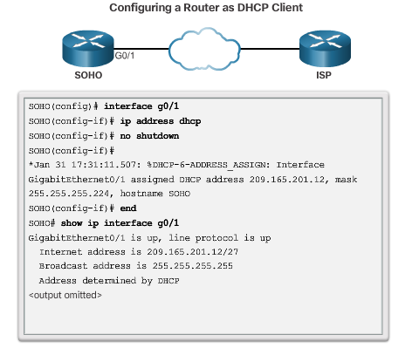
Configure DHCPv4 Client Configuring a Router as a DHCPv4 client
Notes:
8.1 – Dynamic Host Configuration Protocol v4
8.1.3 – Configure DHCPv4 Client
8.1.3.1 - Configuring a Router as a DHCPv4 client

Slide 10
Section 8.1 Terms and Commands
Dynamic Host Configuration Protocol (DHCP)
DHCP Discover (DHCPDISCOVER)
DHCP Offer (DHCPOFFER)
DHCP Request (DHCPREQUEST)
DHCP Acknowledgment (DHCPACK)
Operation (OP) Code
Hardware Address Length
Hops
Transaction Identifier
ip dhcp excluded-address
ip dhcp pool pool-name
default-router
dns-server
domain-name domain
lease
netbios-name-server
no service dhcp
show running-config | section dhcp
show ip dhcp binding
show ip dhcp server statistics
ip helper-address
ip address dhcp
show ip dhcp conflict
debug ip packet
debug ip dhcp server events
Notes:
Terms and Commands

Slide 11
Section 8.2 Terms and Commands
Stateless Address Autoconfiguration (SLAAC)
Dynamic Host Configuration Protocol for IPv6 (Stateful DHCPv6)
Router Advertisement (RA) message
Stateless DHCPv6 Option (Router Advertisement and DHCPv6)
Stateful DHCPv6 (DHCPv6 only)
Stateless DHCPv6 client
Stateful DHCPv6 client
DHCPv6 SOLICIT
DHCPv6 ADVERTISE
DHCPv6 REQUEST
no ipv6 nd managed-config-flag
no ipv6 nd other-config-flag
ipv6 nd other-config-flag
ipv6 nd managed-config-flag
ipv6 dhcp server pool-name
ipv6 enable
ipv6 address autoconfig
show ipv6 dhcp pool
show ipv6 interface type number
debug ipv6 dhcp detail
address prefix
ipv6 dhcp server pool-name
ipv6 dhcp pool pool-name
ipv6 enable
ipv6 address dhcp
show ipv6 dhcp binding
ipv6 dhcp relay destination ipv6_address
show ipv6 dhcp interface type number
Notes:
New Terms and Commands

