Slide 1
Chapter 9: NAT for IPv4
Routing and Switching Essentials v6.0
Notes:
Cisco Networking Academy Program
Routing and Switching Essentials v6.0
Chapter 9: NAT for IPv4

Slide 2
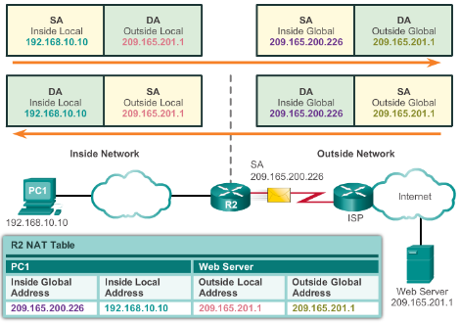
NAT Operation
NAT Characteristics
IPv4 Private Address Space
  10.0.0.0 /8, 172.16.0.0 /12, and 192.168.0.0 /16
What is NAT?
  Process to translate network IPv4 address
  Conserve public IPv4 addresses
  Configured at the border router for translation
NAT Terminology
  Inside address
  Inside local address
  Inside global address
  Outside address
  Outside local address
  Outside global address
Notes:
9.1 – NAT Operation
9.1.1 – NAT Characteristics

Slide 3
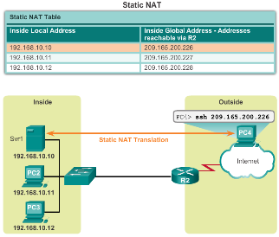
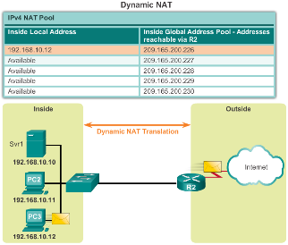
NAT Operation
Types of NAT
Static NAT
  One-to-one mapping of local and global addresses
  Configured by the network administrator and remain constant.
Dynamic NAT
  Uses a pool of public addresses and assigns them on a first-come, first-served basis
  Requires that enough public addresses for the total number of simultaneous user sessions
Port Address Translation (PAT)
  Maps multiple private IPv4 addresses to a single public IPv4 address or a few addresses
  Also known as NAT overload
  Validates that the incoming packets were requested
  Uses port numbers to forward the response packets to the correct internal device
Notes:
9.1 – NAT Operation
9.1.2 – Types of NAT

Slide 4
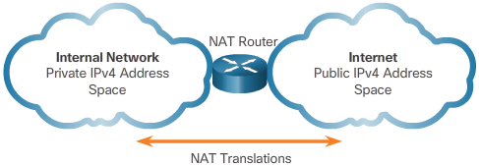
NAT Operation
NAT Advantages
Advantages of NAT
  Conserves the legally registered addressing scheme
  Increases the flexibility of connections to the public network
  Provides consistency for internal network addressing schemes
  Provides network security
Disadvantages of NAT
  Performance is degraded
  End-to-end functionality is degraded
  End-to-end IP traceability is lost
  Tunneling is more complicated
  Initiating TCP connections can be disrupted
Notes:
9.1 – NAT Operation
9.1.3 – NAT Advantages

Slide 5
9.2 Configuring NAT
Notes:
Cisco Networking Academy Program
Routing and Switching Essentials v6.0
Chapter 9: NAT for IPv4

Slide 6
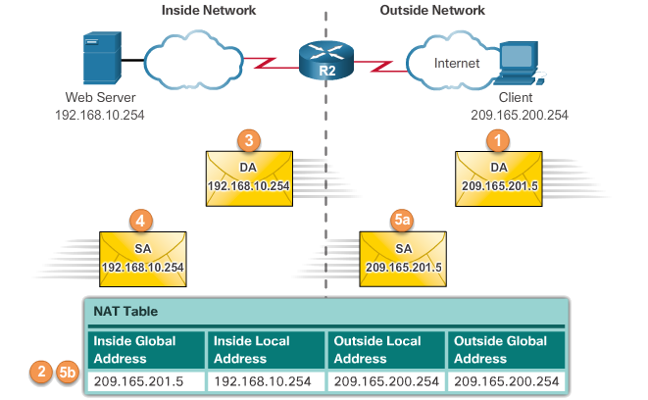
Configuring NAT
Configuring Static NAT
Configuring Static NAT
  Create the mapping between the inside local and outside local addresses
    ip nat inside source static local-ip global-ip
  Define which interfaces belong to the inside network and which belong to the outside network
    ip nat inside
    ip nat outside
Analyzing Static NAT
Verifying Static NAT
  show ip nat translations
  show ip nat statistics
  clear ip nat statistics
Notes:
9.2 – Configuring NAT
9.2.1 – Configuring Static NAT

Slide 7
Configuring NAT
Configuring Dynamic NAT
Dynamic NAT Operation
  The pool of public IPv4 addresses (inside global address pool) is available to any device on the inside network on a first-come, first-served basis.
  With dynamic NAT, a single inside address is translated to a single outside address.
  The pool must be large enough to accommodate all inside devices.
  A device is unable to communicate to any external networks if no addresses are available in the pool.
Notes:
9.2 – Configuring NAT
9.2.2 – Configuring Dynamic NAT

Slide 8
Configuring NAT
Configuring Dynamic NAT (Cont.)
Configuring Dynamic NAT
  Create the mapping between the inside local and outside local addresses
    ip nat pool name start-ip end-ip {netmask netmask | prefix-length prefix-length}
  Create a standard ACL to permit those addresses to be translated
    access-list access-list-number permit source [source-wildcard]
  Bind the ACL to the pool
    ip nat inside source list access-list-number pool name
  Identify the inside and outside interfaces
    ip nat inside
    ip nat outside
Notes:
9.2 – Configuring NAT
9.2.2 – Configuring Dynamic NAT

Slide 9
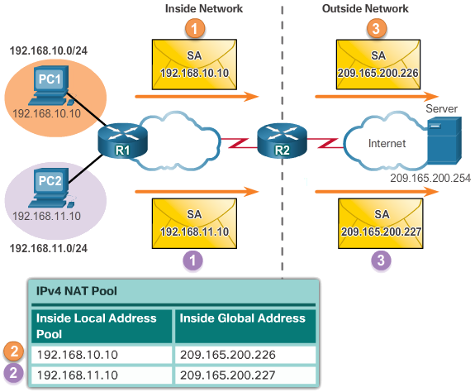
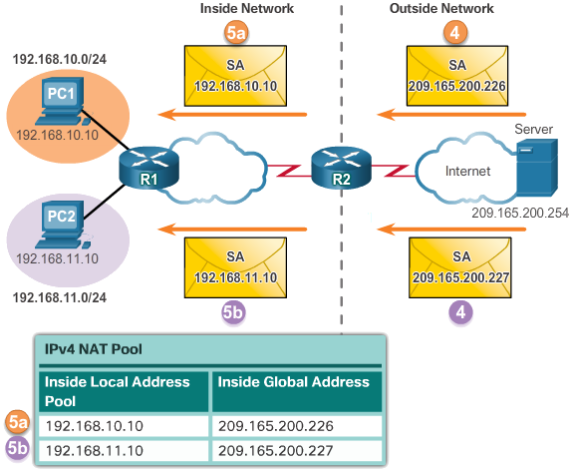
Configuring NAT
Configuring Dynamic NAT (Cont.)
Analyzing Dynamic NAT
Verifying Dynamic NAT
  show ip nat translations
  show ip nat translations verbose
  clear ip nat statistics
  clear ip nat translations *
Notes:
9.2 – Configuring NAT
9.2.2 – Configuring Dynamic NAT

Slide 10
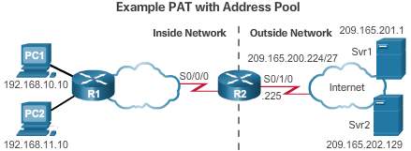
Configuring NAT
Configuring Port Address Translations (PAT)
Configuring PAT: Address Pool
  Create the mapping between the inside local and outside local addresses
    ip nat pool name start-ip end-ip {netmask netmask | prefix-length prefix-length}
  Create a standard ACL to permit those addresses to be translated
    access-list access-list-number permit source [source-wildcard]
  Bind the ACL to the pool
    ip nat inside source list access-list-number pool name
  Identify the inside and outside interfaces
    ip nat inside
    ip nat outside
Notes:
9.2 – Configuring NAT
9.2.3 – Configuring Port Address Translations (PAT)

Slide 11
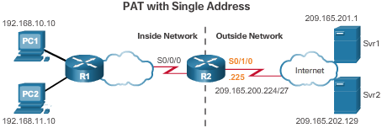
Configuring NAT
Configuring Port Address Translations (PAT) (Cont.)
Configuring PAT: Single Address
  Define a standard ACL to permit those addresses to be translated
    access-list access-list-number permit source [source-wildcard]
  Establish dynamic source translation, specify the ACL, exit interface, and overload option
    ip nat inside source list access-list-number interface type name overload
  Identify the inside and outside interfaces
    ip nat inside
    ip nat outside
Notes:
9.2 – Configuring NAT
9.2.3 – Configuring Port Address Translations (PAT)

Slide 12
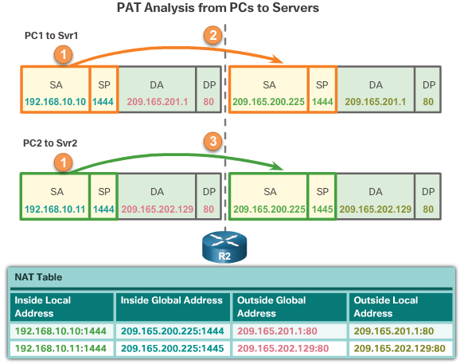
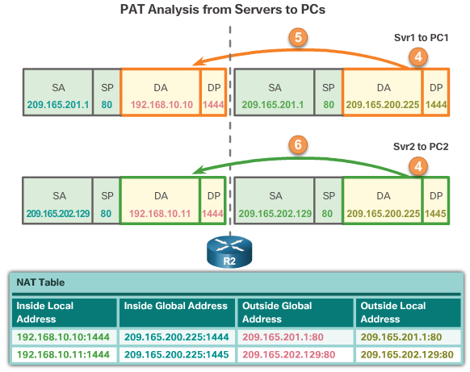
Configuring NAT
Configuring Port Address Translations (PAT) (Cont.)
Analyzing PAT
Verifying PAT
  show ip nat translations
  show ip nat statistics
  slear ip nat statistics
Notes:
9.2 – Configuring NAT
9.2.3 – Configuring Port Address Translations (PAT)

Slide 13
9.3 Troubleshooting NAT
Notes:
Cisco Networking Academy Program
Routing and Switching Essentials v6.0
Chapter 9: NAT for IPv4

Slide 14
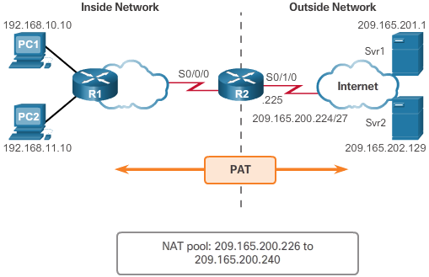
Troubleshooting NAT
Troubleshooting NAT Configurations
Troubleshooting NAT: show commands
  clear ip nat statistics
  clear ip nat translations *
  show ip nat statistics
  Show ip nat translations
Troubleshooting NAT: debug commands
  debug ip nat
Notes:
9.3 – Troubleshooting NAT
9.3.1 – Troubleshooting NAT Configurations

Slide 15
Section 9.1
New Terms and Commands
Dynamic Network Address Translation (Dynamic NAT)
Global Address
Inside Address
Inside Global Address
Inside Local Address
Local Address
Network Address Translation (NAT)
Outside Address
Outside Global Address
Outside Local Address
Port Address Translation (PAT)
Private Address
Public Address
RFC 1918
Static Network Address Translation (Static NAT)
Notes:
New Terms and Commands

Slide 16
Section 9.2
New Terms and Commands
show ip nat statistics command
clear ip nat statistics command
clear ip nat translation * command
ip nat inside source command
ip nat inside source list access-list-number pool name command
ip nat pool command
ip nat translation timeout command
NAT64
Overload
Port Forwarding
show ip nat statistics command
show ip nat translations command
Unique Local Address (ULA)
Notes:
New Terms and Commands

